Slide 1
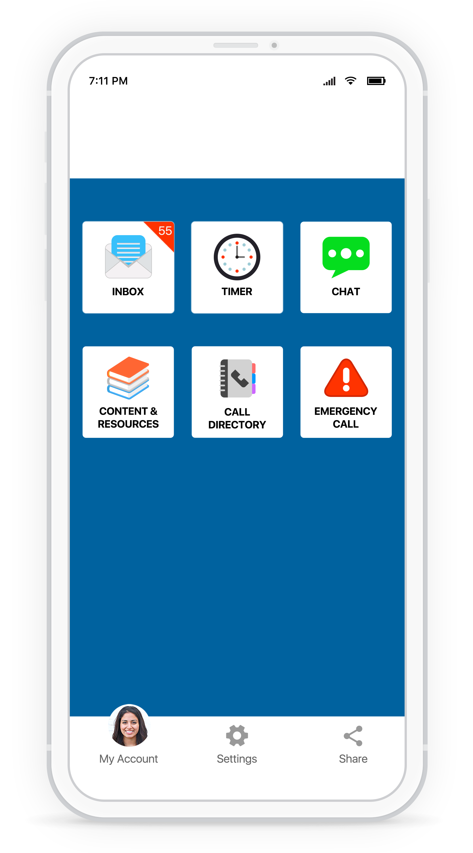
Download the Rave Guardian™ app today.

Slide 2
Download the Rave Guardian™ app today.

Slide 3
One-Click Emergency Dial
Access Important Documents
Contact Campus Departments

Slide 4
Communicate with Campus Safety
Receive Campus Notifications
Set a Safety Timer

