Slide 2
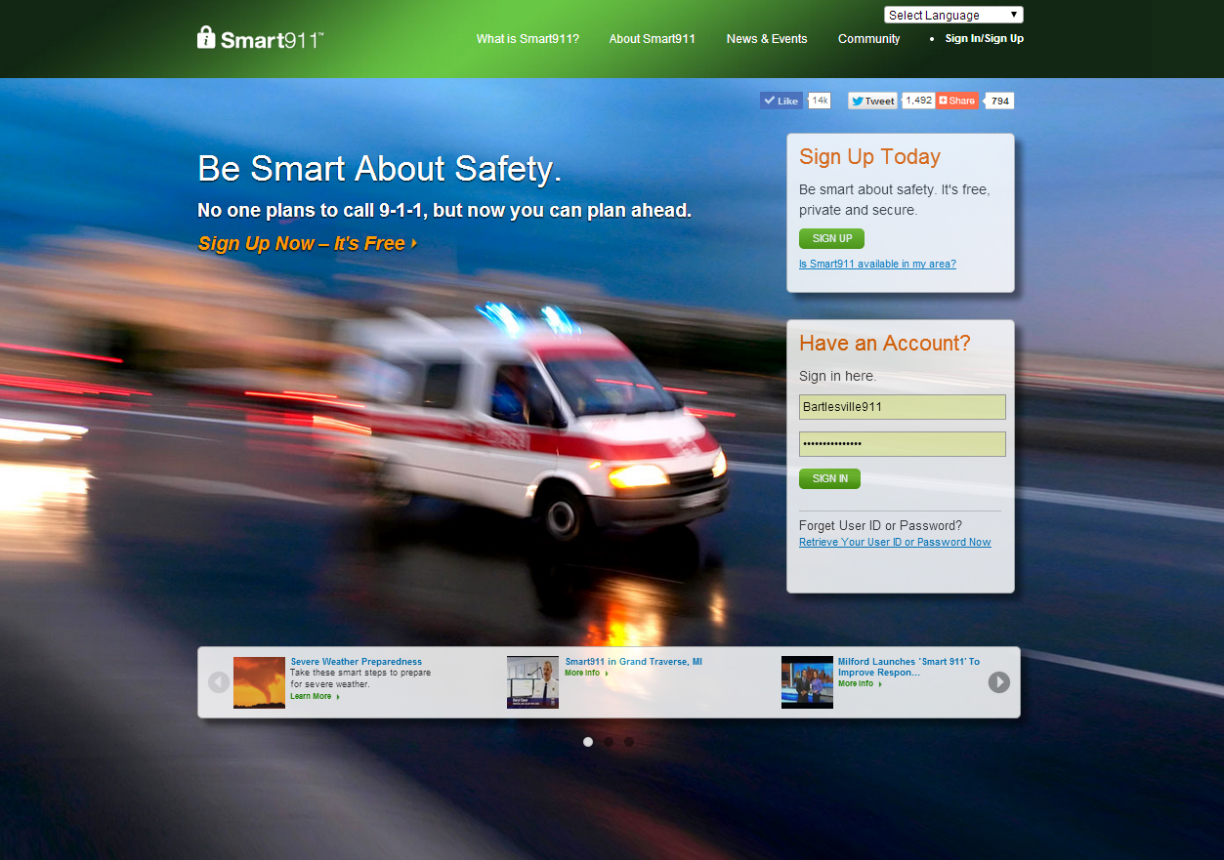
What is Smart911?
Private and secure website
Citizens create a Safety Profile of valuable information they want to provide 9-1-1 call takers and first responders
Service is free to citizens

Slide 3
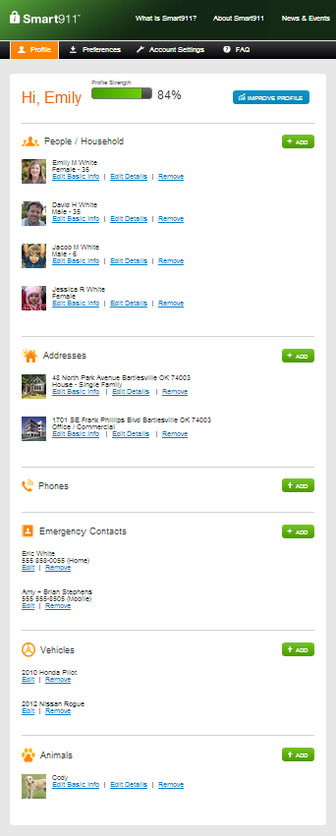
Include home and work addresses
Enter all household residents
Add all mobile, landline and VOIP lines
Add all emergency contacts and their contact information
If any pets live in the home, add them here
Include vehicles and vehicle descriptions

Slide 4
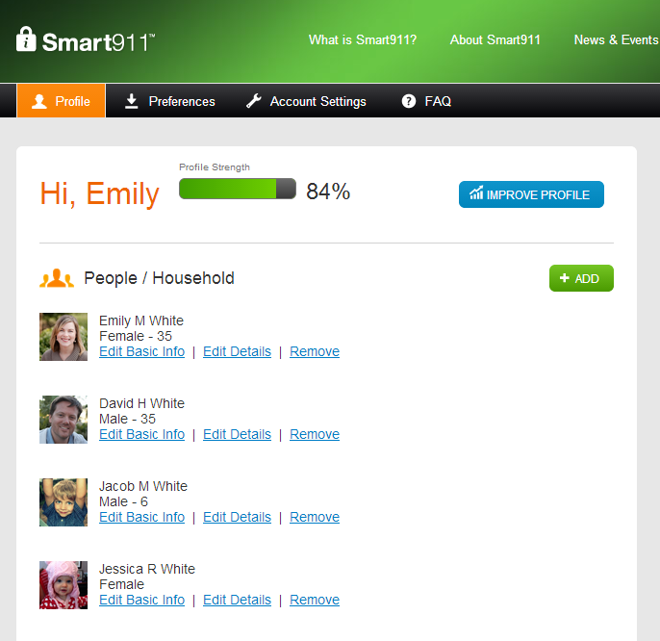
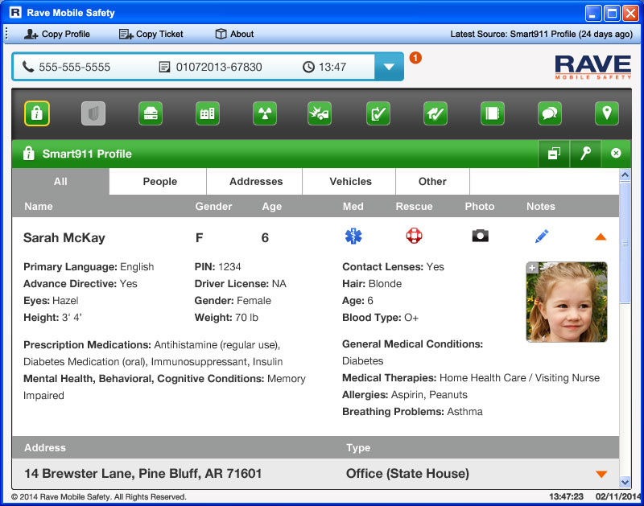
How Does Smart911 Work?
What 9-1-1 Sees…
What citizens create…

Slide 5
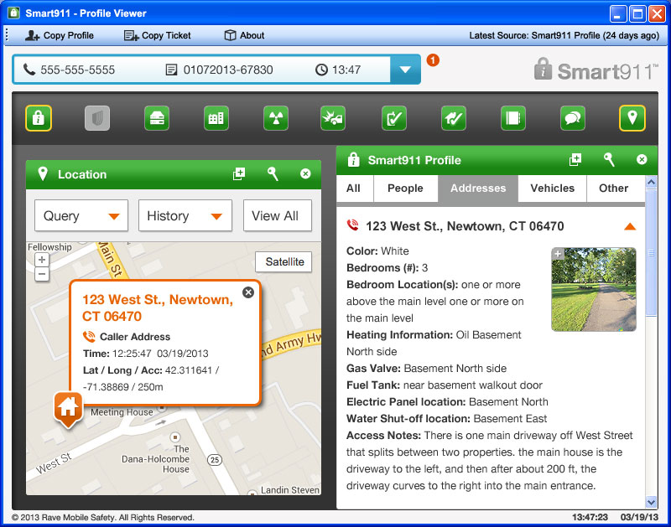
When Does Smart911 Help?
Unknown Address and Location
Mobile phones can be linked to specific addresses:
Home
Work
School
Result: 9-1-1 knows who is calling and where they are located.
Notes:
"I had my 1st experience with Smart911 March 2011 with an Acute Asthma Attack. My information was in there and complete, the units were there in minutes, and the dispatcher stayed on the line with me. With the care I received on the way to the hospital I can't even begin to think of anything to improve.“ Jane V. - Goodlettsville, TN

Slide 6
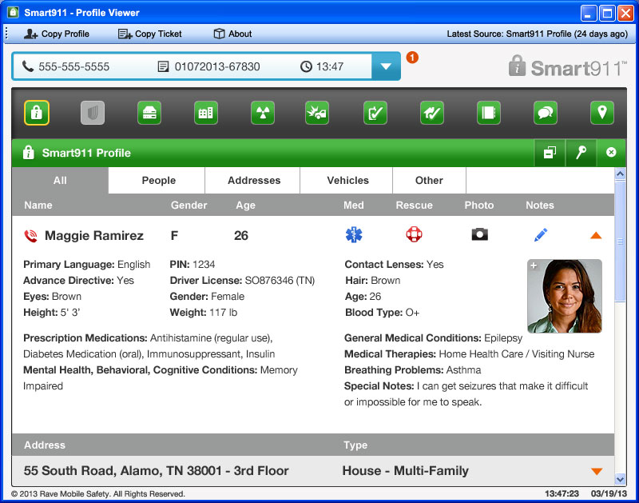
When does Smart911 Help?
Caller Cannot Communicate
Caller by not be able to communicate due to:
Allergic reaction
Heart attack
Home invasion
Result: Information is immediately available and caller doesn’t need to be the sole source of information.
Notes:
In Illinois, a 9-1-1 call was received with no response by the caller other than some gagging sounds. The call came from a mobile phone with a general location hit. The Smart911 Safety Profile indicated that the caller had an allergy to bee stings and her home address was within the range of her cell phone call. EMS was able to respond immediately to treat her bee sting.

Slide 7
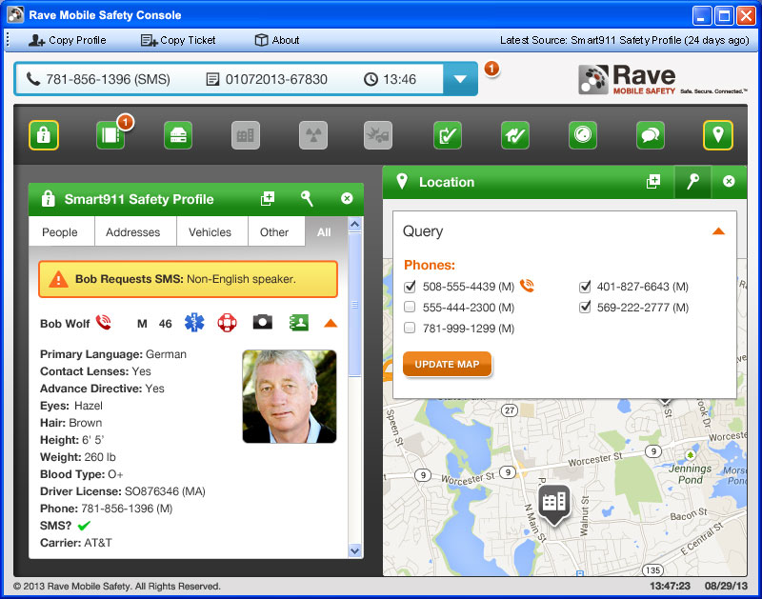
When does Smart911 Help?
Medical Emergency
Important medical information can be included:
Medical issues
Medications
Allergies
Result: Knowing these details ahead of time can help avoid allergic reactions or dangerous medication combinations.
Notes:
In Fort Smith Arkansas, a 4 year old boy was playing in his yard with his siblings when he fell into a grill and cut his face. In a panic his mother dialed 9-1-1 for help, forgetting to alert them to his fatal latex allergy. Her Safety Profile provided those vital details.

Slide 8
When does Smart911 Help?
Missing Child
Smart911 Safety Profile displays:
Recent photo
Physical description
Medical conditions
Result: 9-1-1 call takers can immediately forwarded picture and description to officers in the field for a faster response.

Slide 9
Create your own Safety Profile at www.smart911.com and help us spread the word to citizens.

