Slide 2
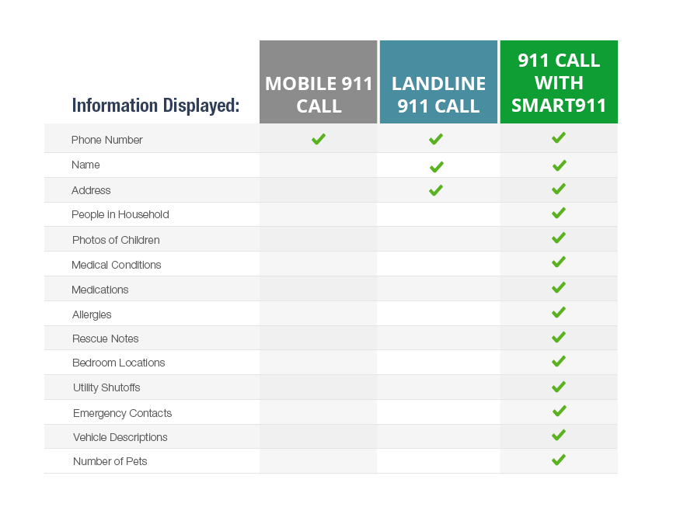
Why Sign Up for a Safety Profile?
Notes:
When you dial 9-1-1, the 9-1-1 call taker is only able to see very limited amounts of information about you. Below you can see the drastic difference between a landline 9-1-1 call, a mobile 9-1-1 call and a call with a Smart911 Safety Profile.
80% of 9-1-1 calls do not provide an exact location
With mobile phones, it can take much longer to get the exact address and the call taker usually relies on the 9-1-1 caller to provide their exact location.

Slide 3
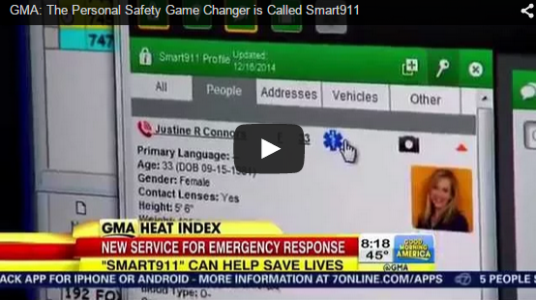
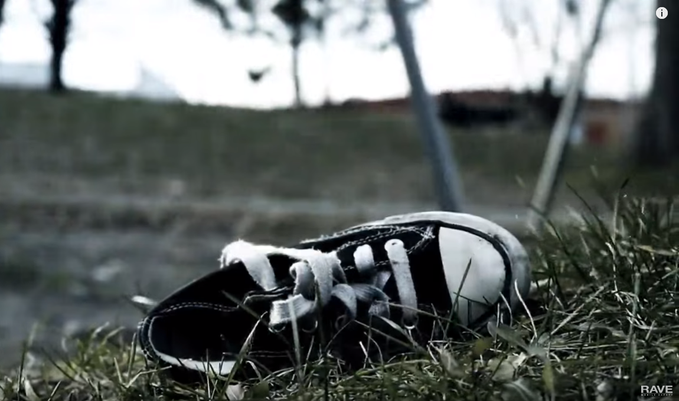
Smart911 Videos
GMA: THE PERSONAL SAFETY GAME
CHANGER IS CALLED SMART911
WHAT IF YOU NEED TO DIAL 911?
Notes:
Must be connected to the internet connection to view the YouTube video

Slide 4
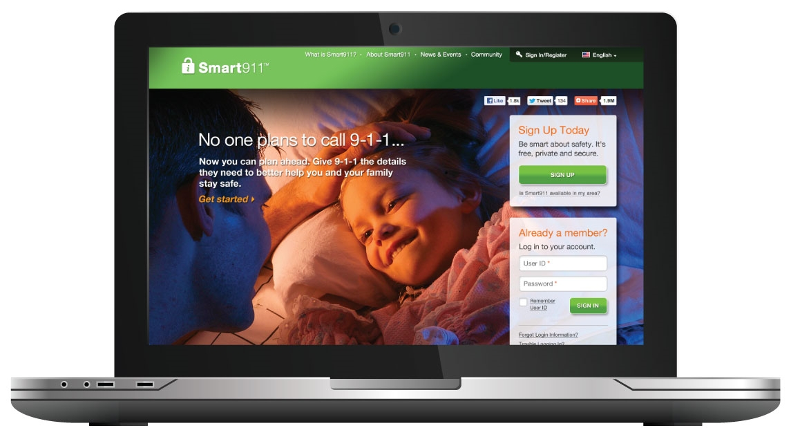
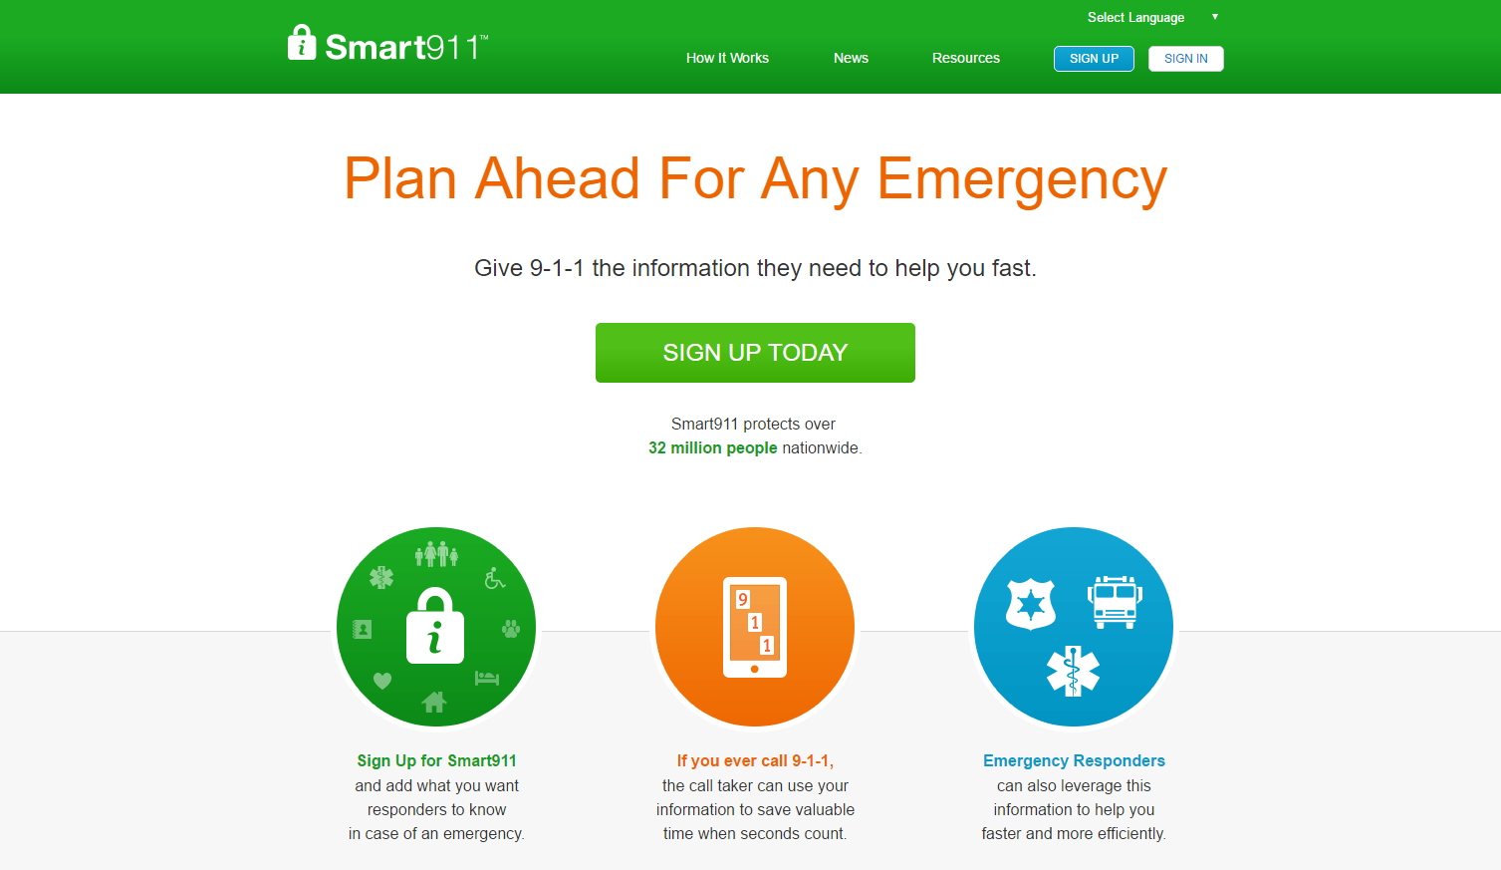
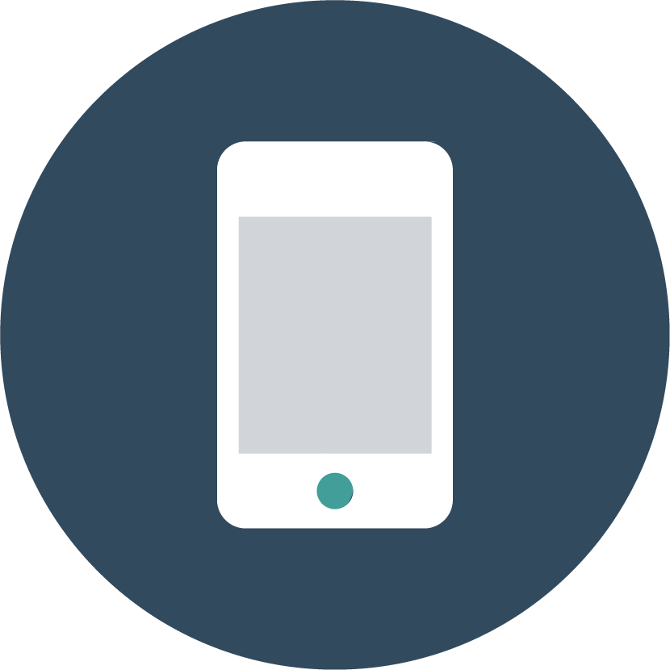
What is Smart911?
Private and secure website
Individuals create a Safety Profile of valuable information they want to provide 9-1-1 call takers and first responders
Service is free
Sign up at:
www.smart911.com or Smart911 App

Slide 5
Smart911 App
Easily create a Smart911 Safety Profile
Keeping profiles up-to-date
Free geo-based weather notifications
Location-aware alerting

Slide 6
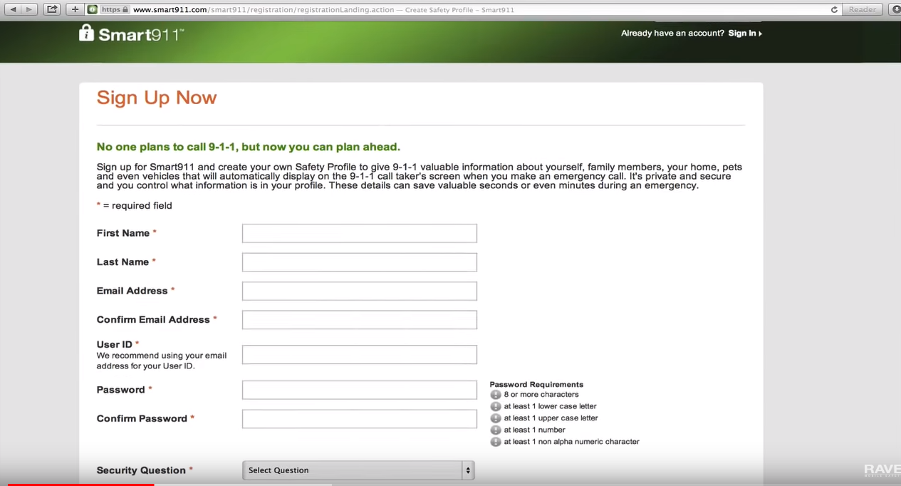
Smart911 Videos
How to Sign Up for Smart911
Notes:
Must be connected to the internet connection to view the YouTube video

Slide 7
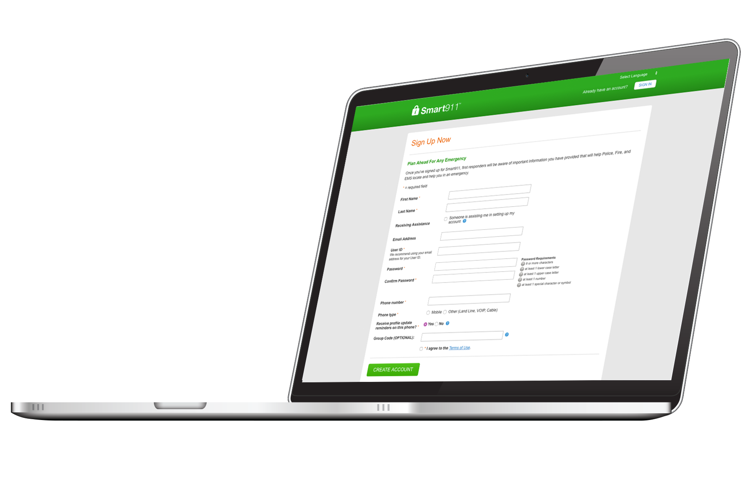
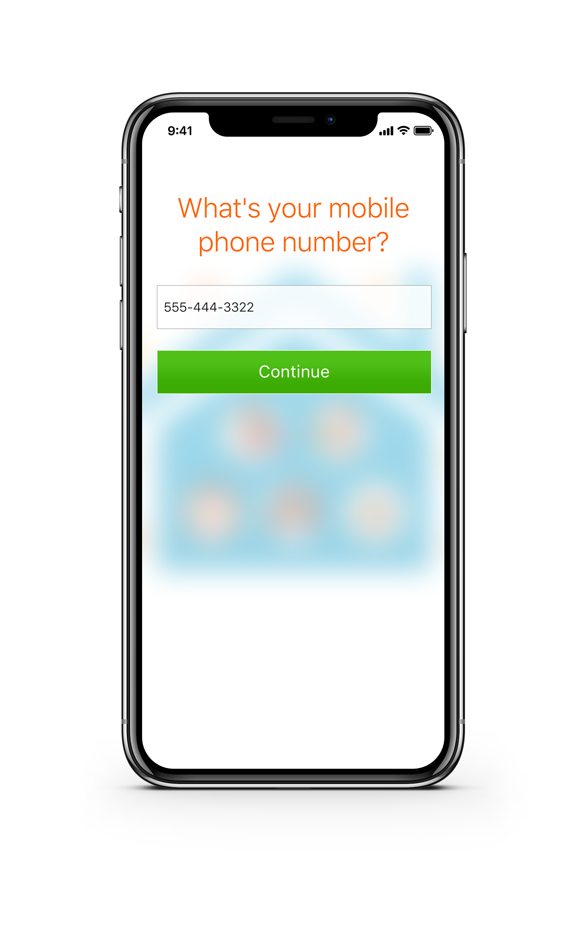
It’s Quick, Easy, and Can Save Your Life
Registration is simple and takes less than 5 minutes
The information you provide will display automatically to the 911 call taker’s screen when you make an emergency call
These details can save seconds or even minutes during an emergency
Sign up at
Smart911.com or Smart911 App

Slide 8
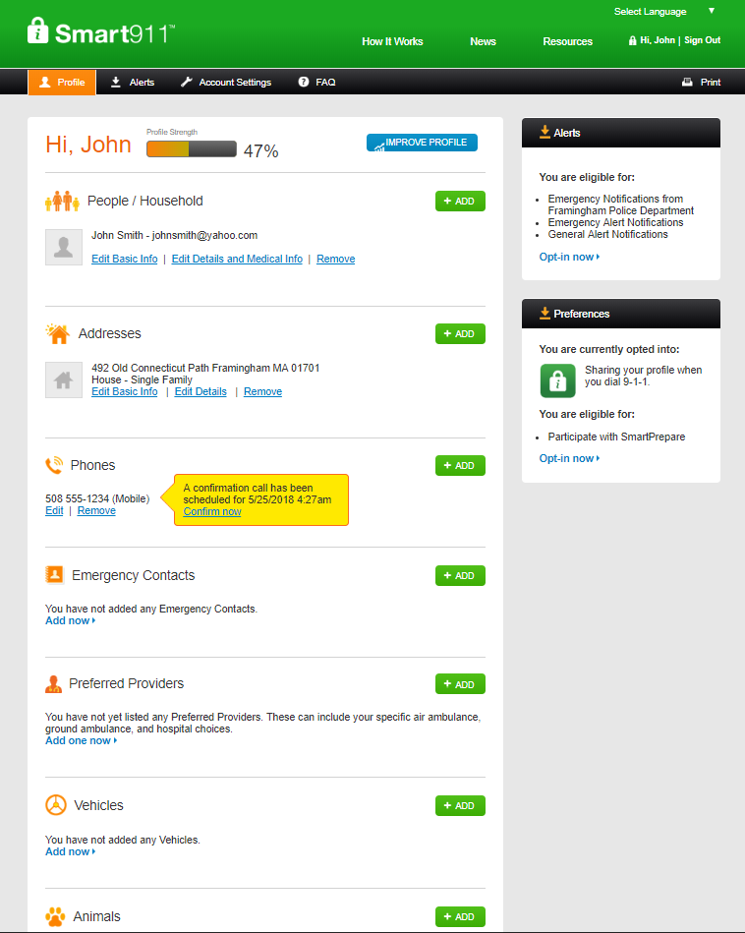
Include home and work addresses
Enter all household residents
Add all mobile, landline and VOIP lines
Add all emergency contacts and their contact information
If any pets live in the home, add them here
Include vehicles and vehicle descriptions
Sign up at Smart911.com or Smart911 App

Slide 9
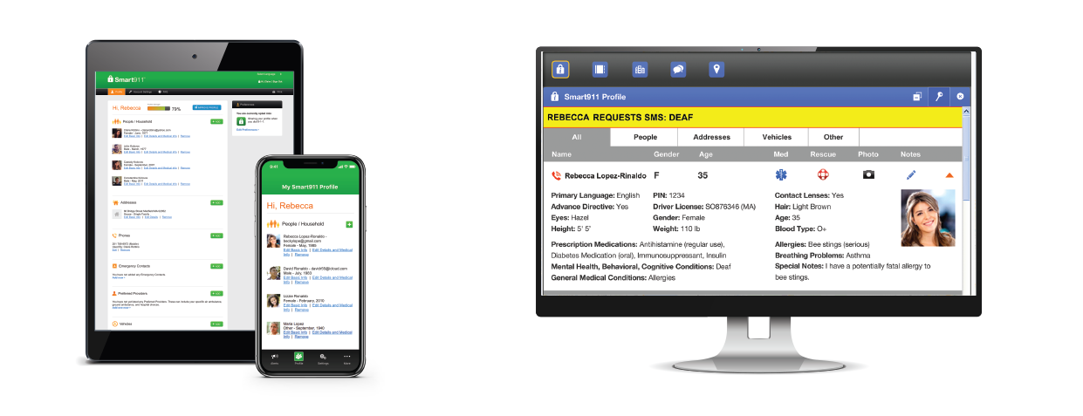
How Does Smart911 Work?
What 9-1-1 Sees…
What individuals create…
Notes:
Smart911 allows individuals to provide the additional details that 9-1-1 call takers may need in order to assist them during an emergency. When you dial 9-1-1 today the information received by the 9-1-1 call center can be limited based on the type of phone you are calling on. With Smart911, anytime you make an emergency call from a phone registered with your Safety Profile, the 9-1-1 systems recognizes your phone number and automatically displays your profile on the screen of the call taker who receives your call.

Slide 10
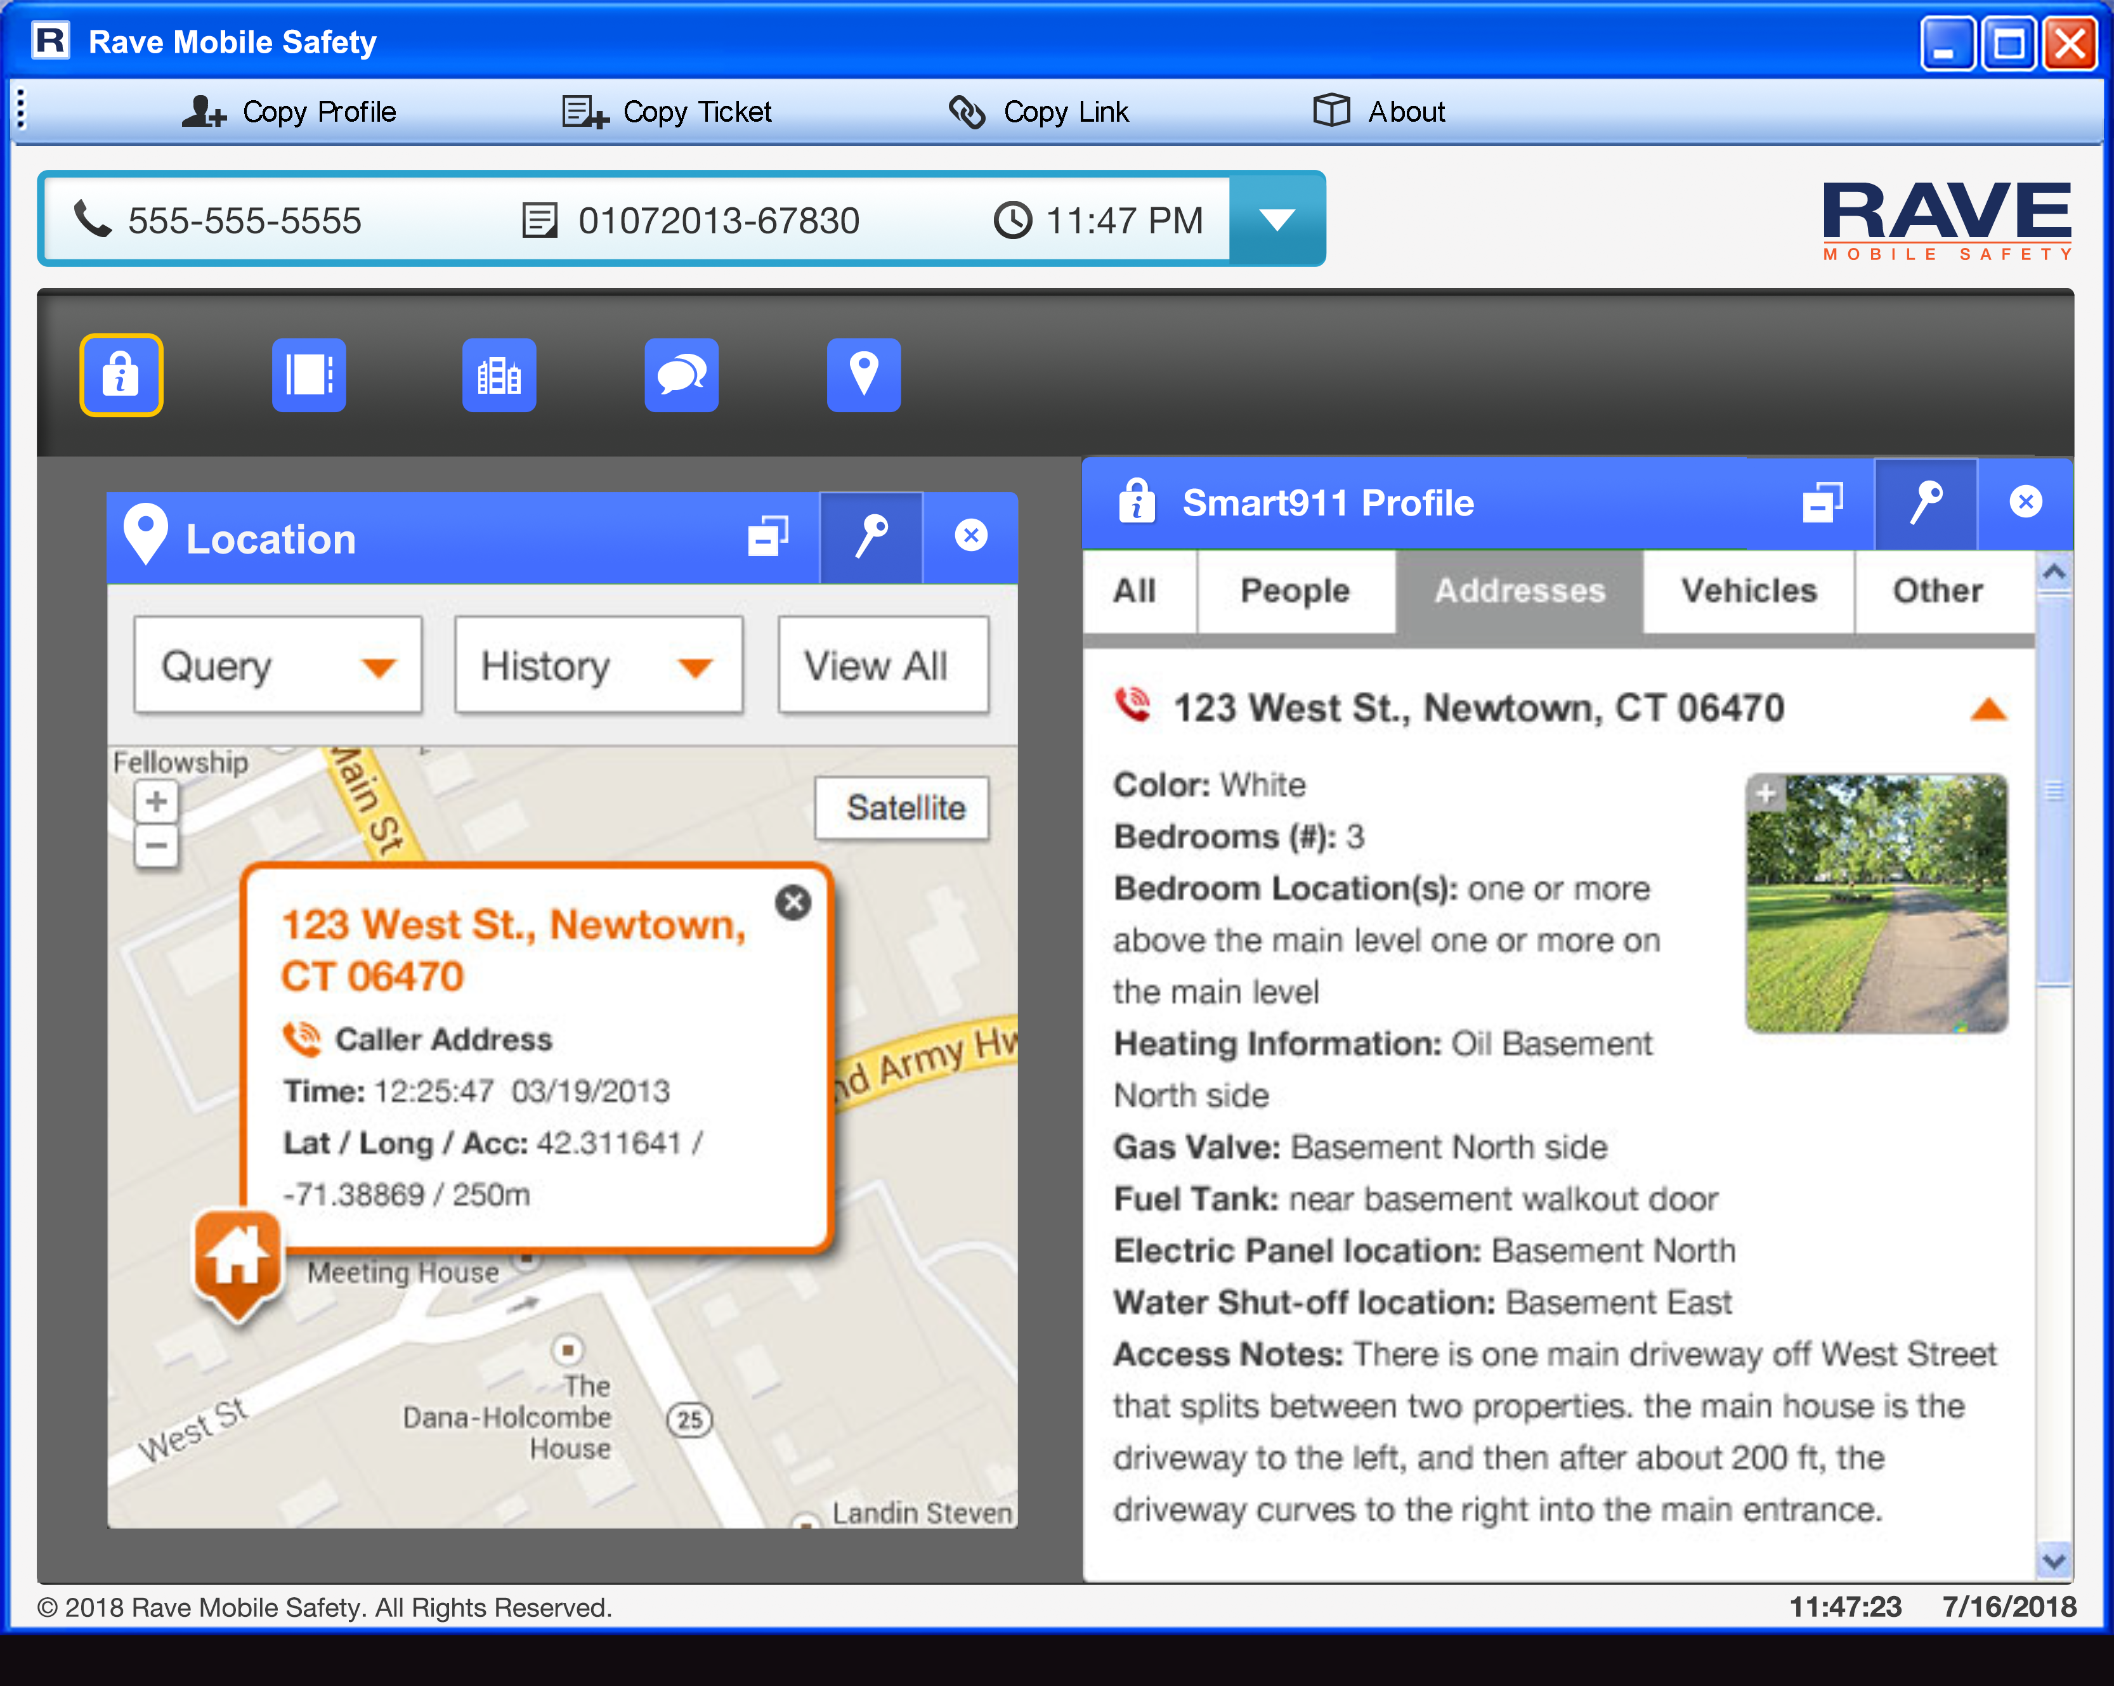
When Does Smart911 Help?
Unknown address and location
Mobile phones can be linked to specific addresses:
Home
Work
School
Result: 9-1-1 knows who is calling and where they are located.
Notes:
"I had my 1st experience with Smart911 March 2011 with an Acute Asthma Attack. My information was in there and complete, the units were there in minutes, and the dispatcher stayed on the line with me. With the care I received on the way to the hospital I can't even begin to think of anything to improve.“ Jane V. - Goodlettsville, TN

Slide 11
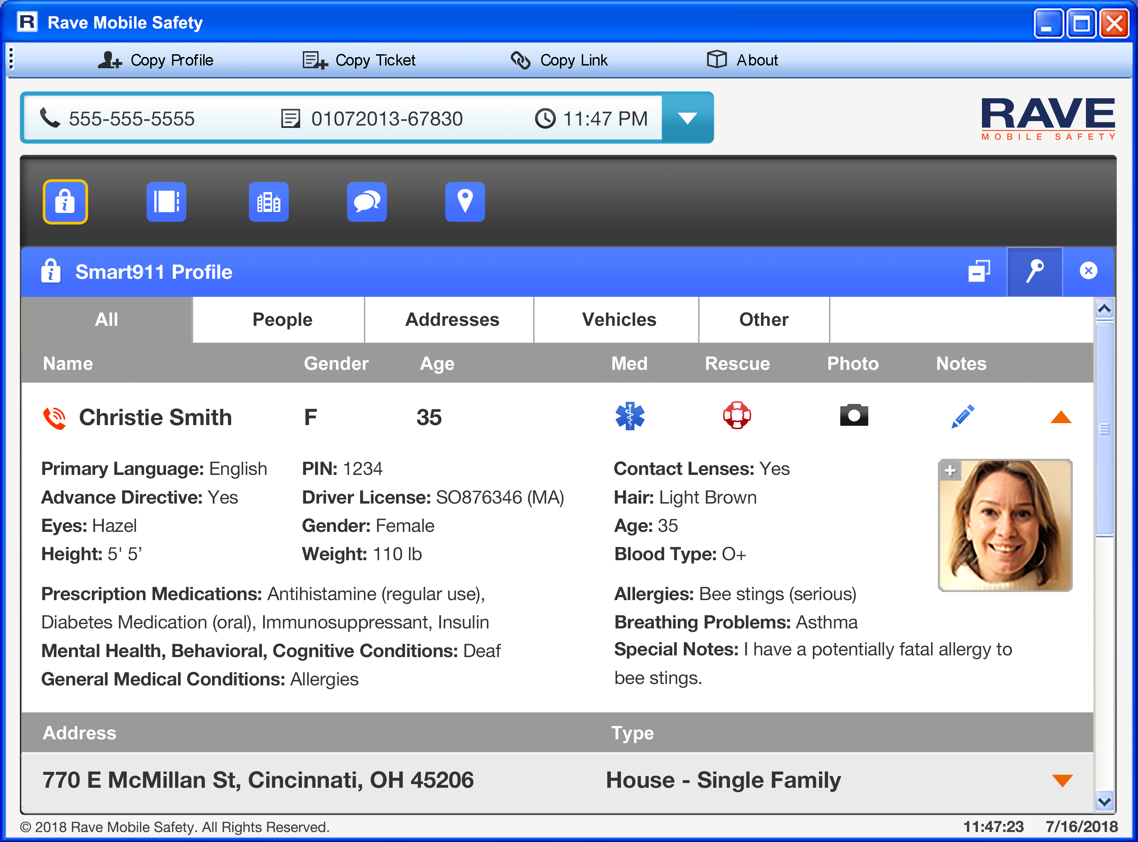
When does Smart911 Help?
Caller cannot communicate
Caller by not be able to communicate due to:
Allergic reaction
Heart attack
Home invasion
Result: Information is immediately available and caller doesn’t need to be the sole source of information.
Notes:
In Illinois, a 9-1-1 call was received with no response by the caller other than some gagging sounds. The call came from a mobile phone with a general location hit. The Smart911 Safety Profile indicated that the caller had an allergy to bee stings and her home address was within the range of her cell phone call. EMS was able to respond immediately to treat her bee sting.

Slide 12
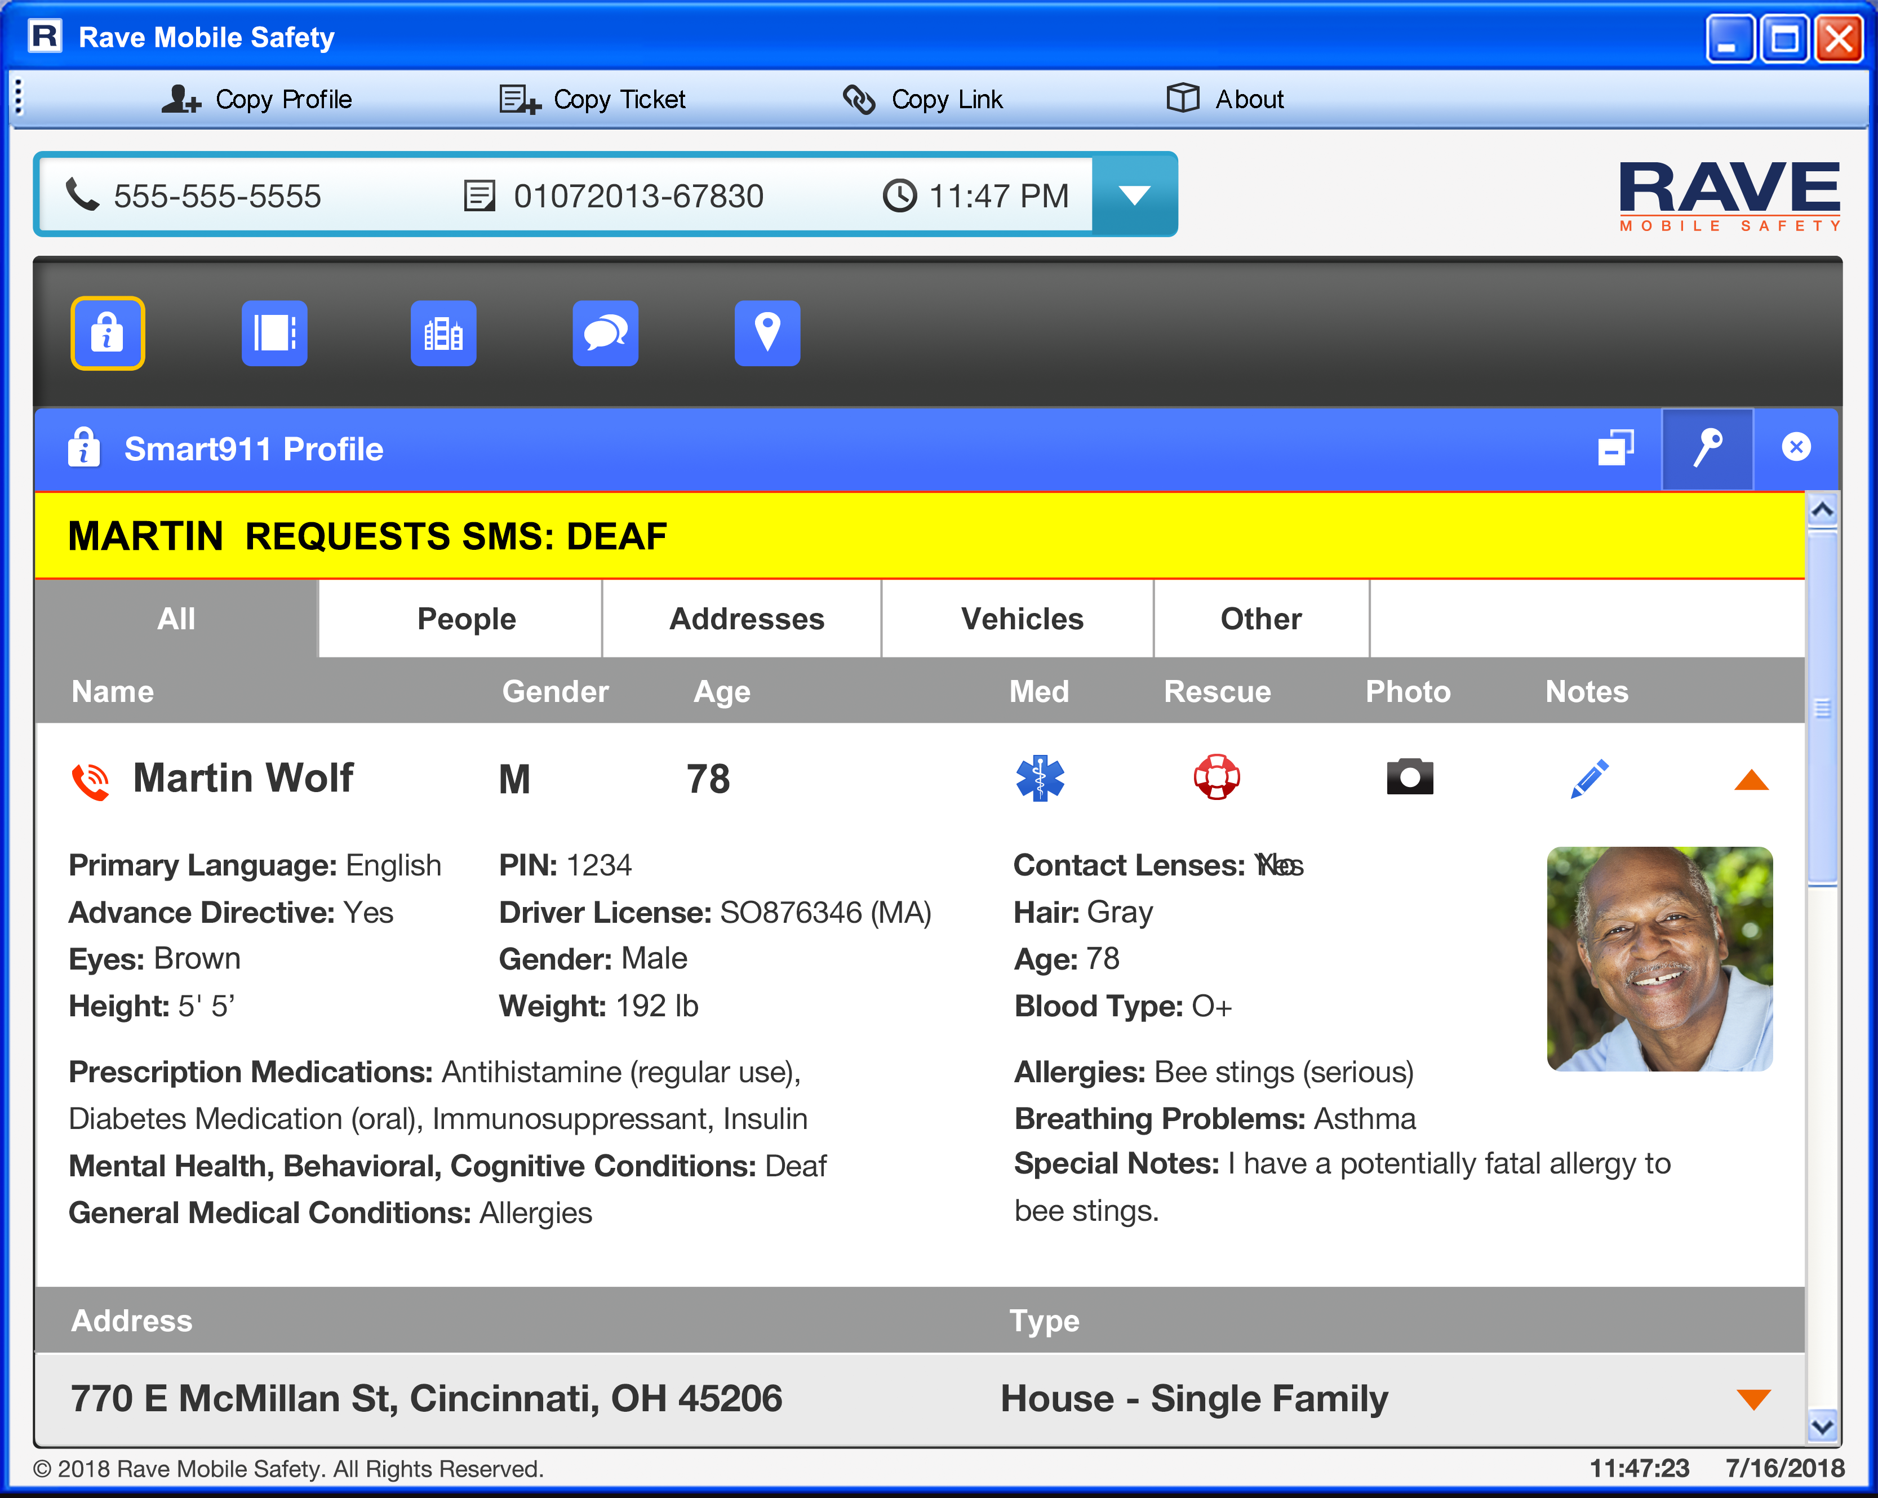
When does Smart911 Help?
Medical emergency
Important medical information can be included:
Medical issues
Medications
Allergies
Result: Knowing these details ahead of time can help avoid allergic reactions or dangerous medication combinations.
Notes:
In Fort Smith Arkansas, a 4 year old boy was playing in his yard with his siblings when he fell into a grill and cut his face. In a panic his mother dialed 9-1-1 for help, forgetting to alert them to his fatal latex allergy. Her Safety Profile provided those vital details.

Slide 13
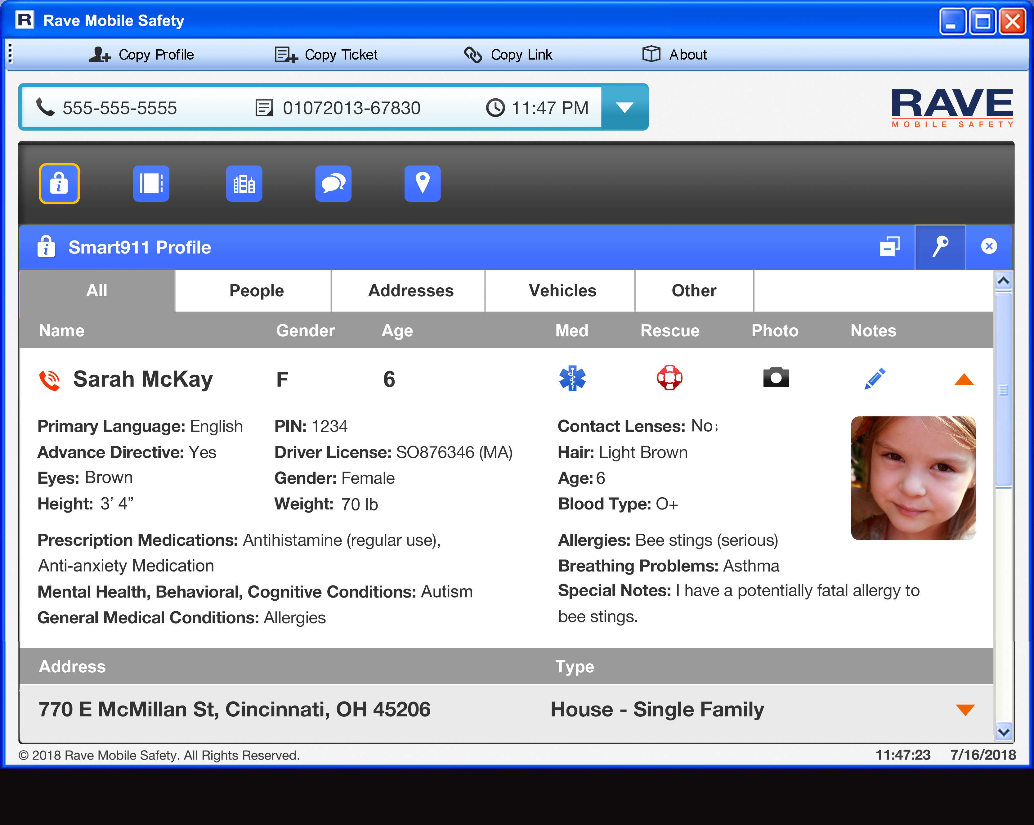
When does Smart911 Help?
Missing child
Smart911 Safety Profile displays:
Recent photo
Physical description
Medical conditions
Result: 9-1-1 call takers can immediately forwarded picture and description to officers in the field for a faster response.

Slide 14
Security and Privacy
You Decide What to Include
Provide as much or as little information as you want. Smart911 only asks for information that is relevant to aid emergency response.
Only Seen If You Call 9-1-1
Your information is only available to 9-1-1 call takers and ﬁrst responders if you have an emergency.
Industry Leading Security
Your information is housed in top-tier secure facilities complete with 24/7 physical security, video surveillance, and alarms. We utilize the same SSL certificate authority and encryption technologies used by leading ﬁnancial institutions.

Slide 15
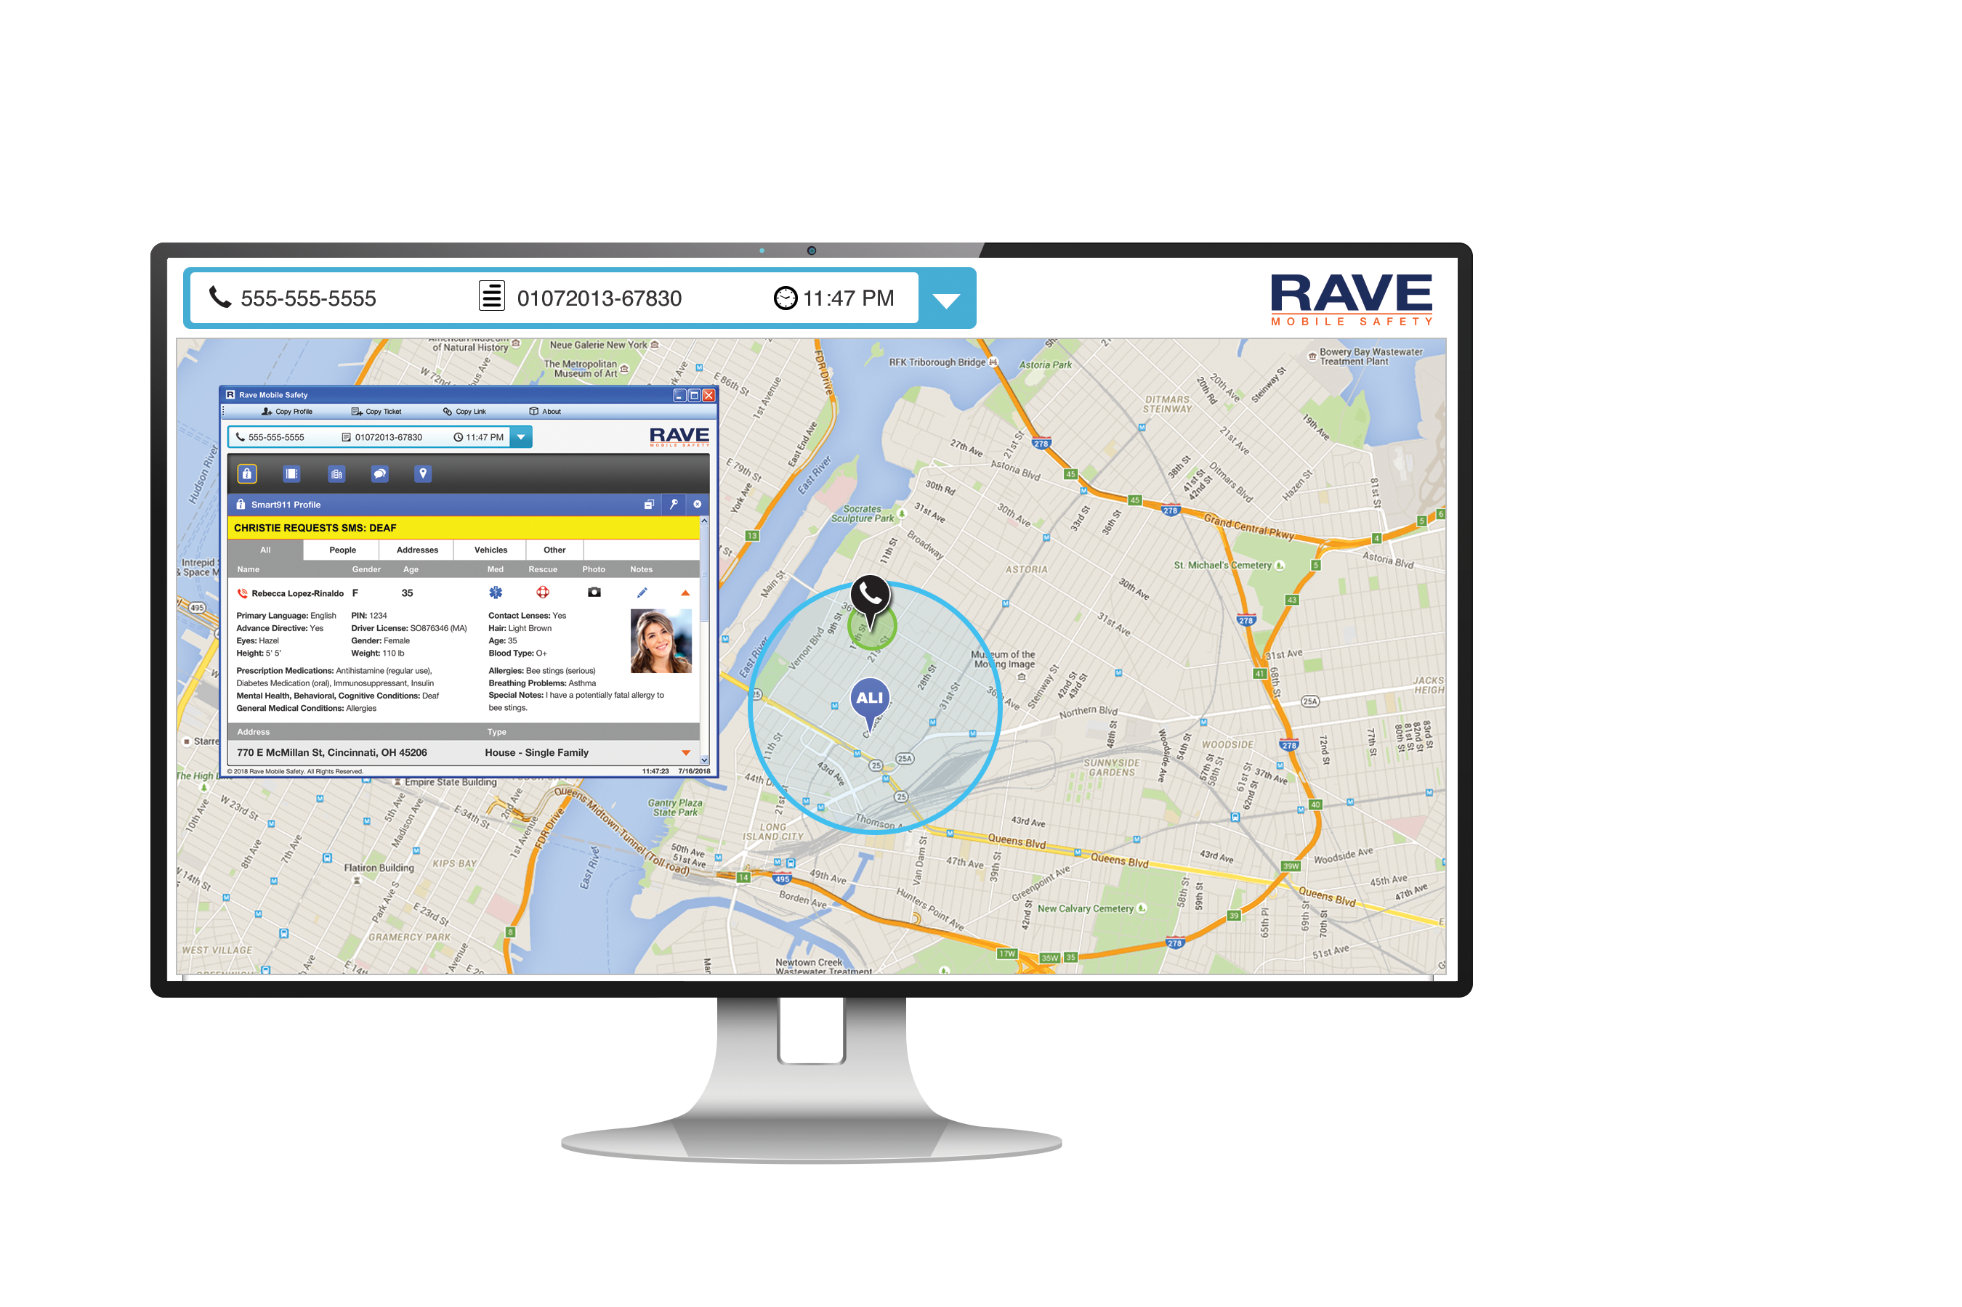
More Accurate Mobile Caller Location
Smart911 enhanced location data gives 9-1-1 call takers improved, consolidated location information and refines mobile ALI locations into a single view. We collect location data from multiple sources to give call takers the most accurate available:
Mobile ALI – the primary source of 9-1-1 location data.
Smart911 Safety Profile – work and home addresses provided by individuals.
RapidSOS Clearinghouse – highly accurate using best available smartphone technology including GPS and Wi-Fi

Slide 16
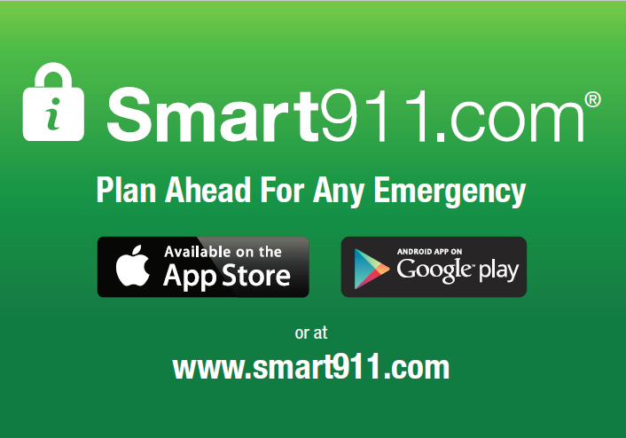
Create your Safety Profile today
and help spread the word!

