Slide 1
Connecting You
With Those You Protect
Alerts Powered By Smart911 Marketing Kickoff

Slide 2
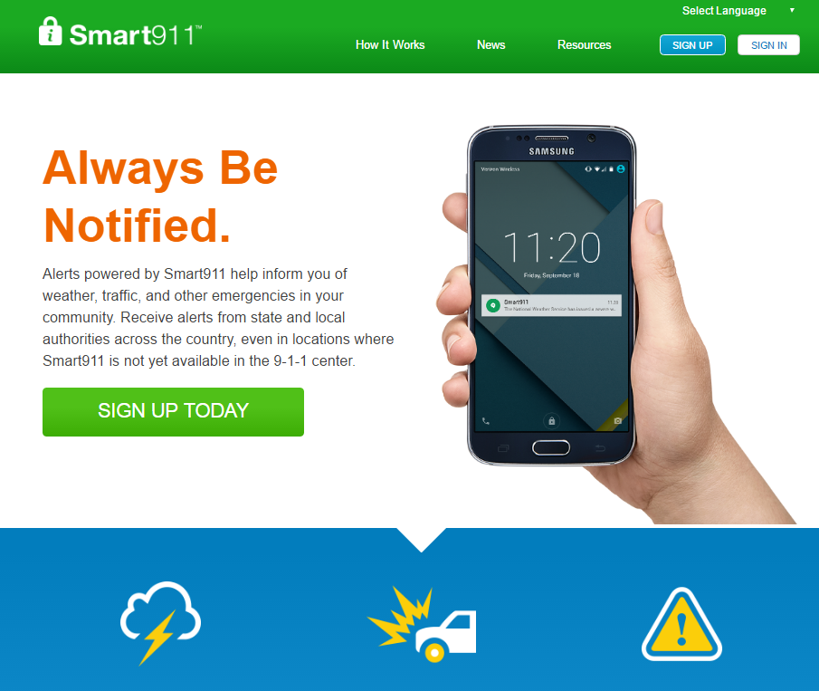
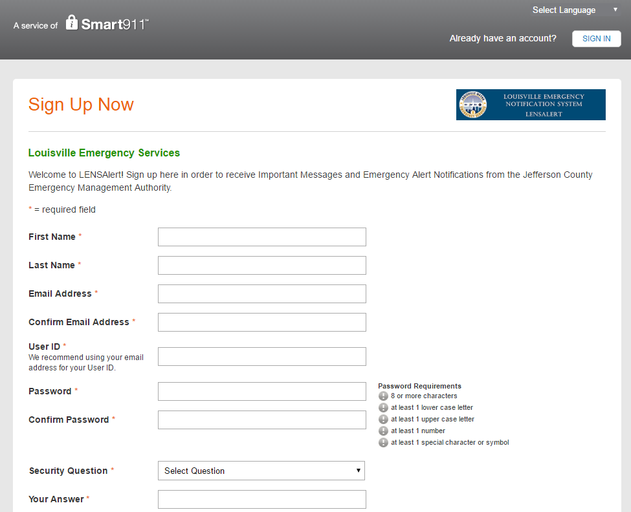
Alert Landing Page
Direct your residents to one place where they can get information and sign up.
Web page with information about Alerts
Customized Registration Portal

Slide 3
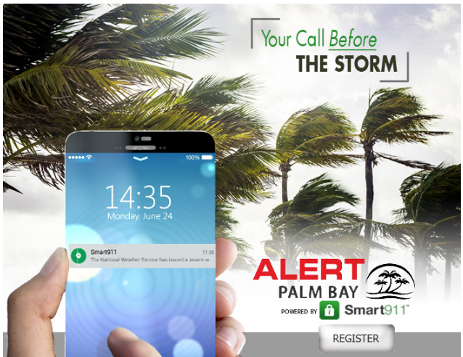
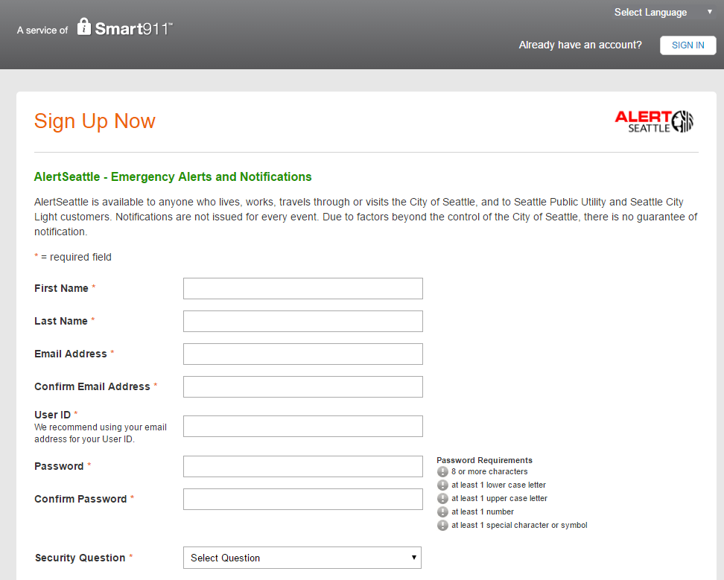
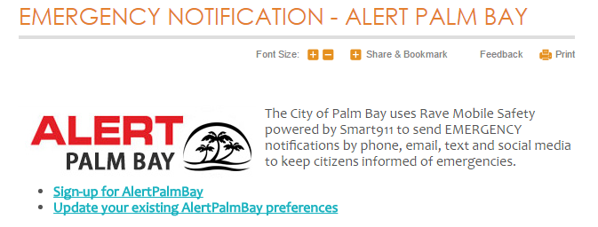
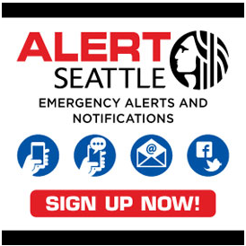
Customized Registration Portal
Citizens register at unique registration URL
Draft of press release
Landing page text and FAQs provided
Branding and customization completed by municipality

Slide 4
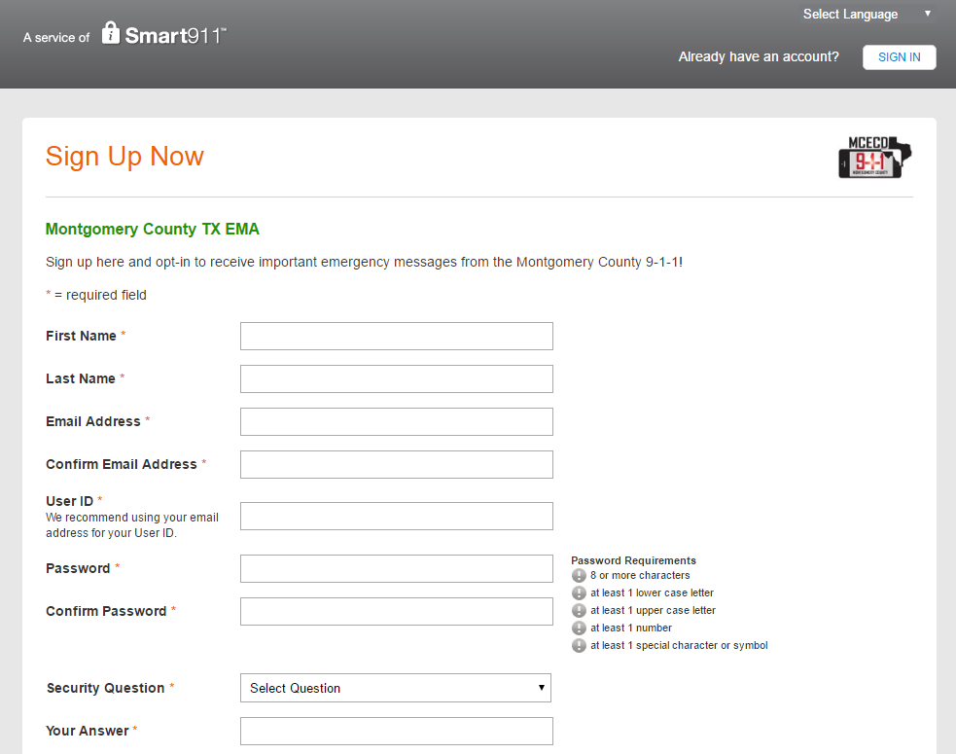
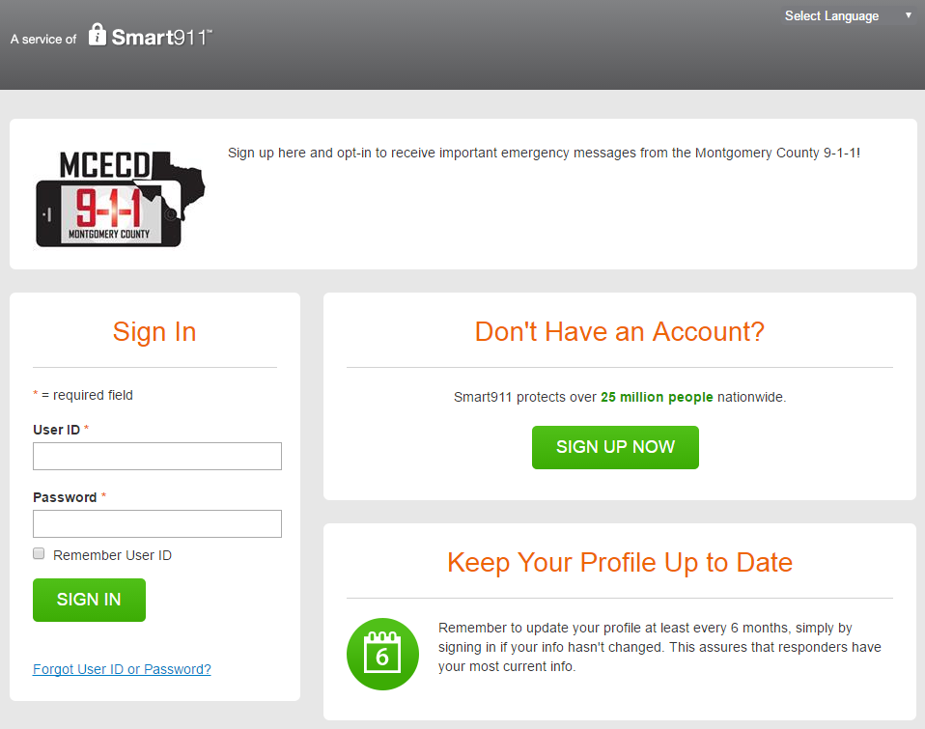
Provided Two Registration URLS
Registration Referral URL
Login Referral URL
Direct citizens here to register
Link to this page from landing page, emails, social media, and press releases
Direct citizens here to login and update their account
Link to this page from landing page

Slide 5
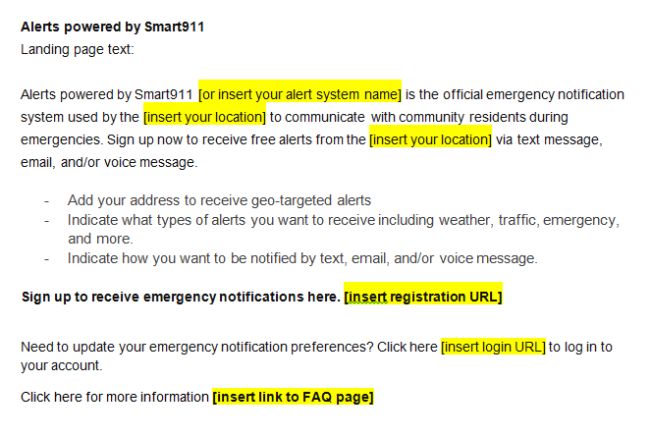
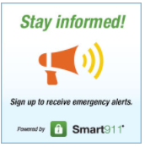
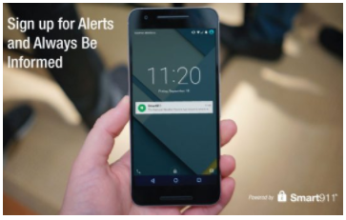
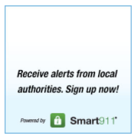
Promote Alerts on Your Website
Add web badge to your homepage
Create a landing page
Link to registration URL
Link to FAQs
Post press release

Slide 6
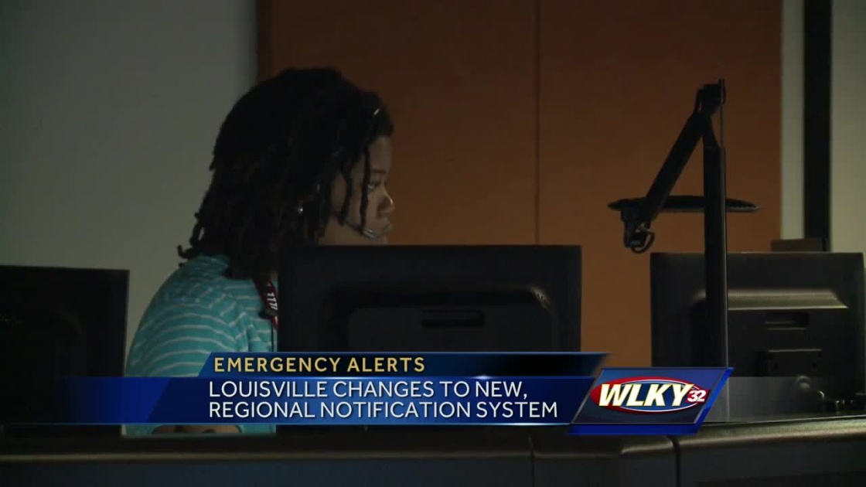
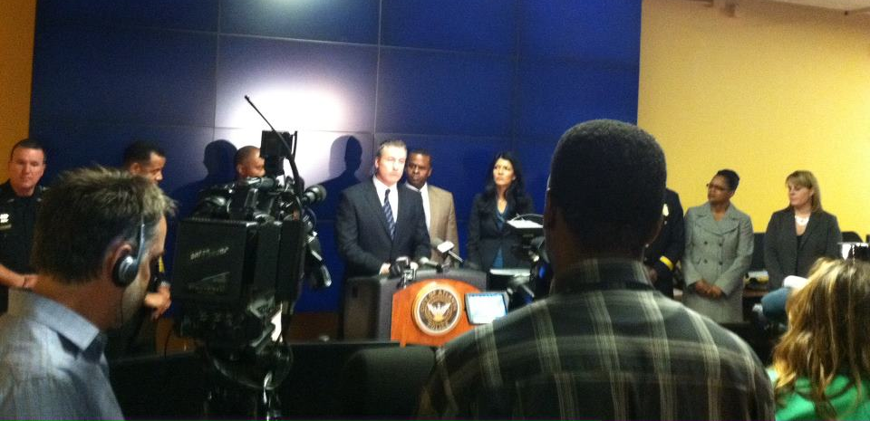
Public Launch – Media Communications
Media Outreach
Do you want a press conference or press release?
Rave Provides:
Drafted Press Release
Marketing toolkit
Landing page text
FAQS

Slide 7
Marketing Best Practices

Slide 8
Utilize Your Remaining Minutes
Send reverse 9-1-1 message / alert
Do you have any messaging minutes remaining?
Message your current registrants to sign up for alerts starting 6 weeks before you switch
Electronic Communications
Email blasts, Website, Social Media, e-Newsletter
Printed Materials / Mailings
Flyers, Direct Mailings, Newsletters
Severe weather messaging
Pre and post storm

