Slide 1
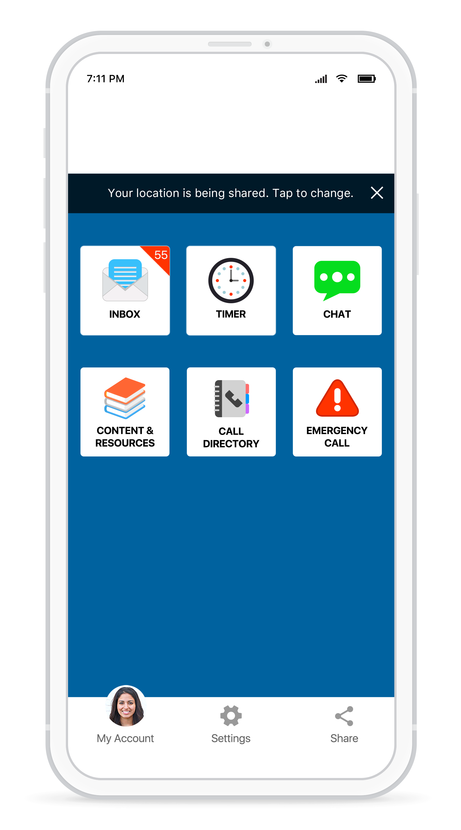
See Something,
Text Something
Stay connected and receive important campus notifications, communicate with
campus safety, and gain access to resources and documents you need most.
RaveGuardian.com

Slide 2
One App,
Hundreds of Campus Resources
Stay connected and receive important campus notifications, communicate with
campus safety, and gain access to resources and documents you need most.
RaveGuardian.com

Slide 3
Make Your Mom Happy
Stay connected and receive important campus notifications, communicate with
campus safety, and gain access to resources and documents you need most.
RaveGuardian.com

