Slide 1
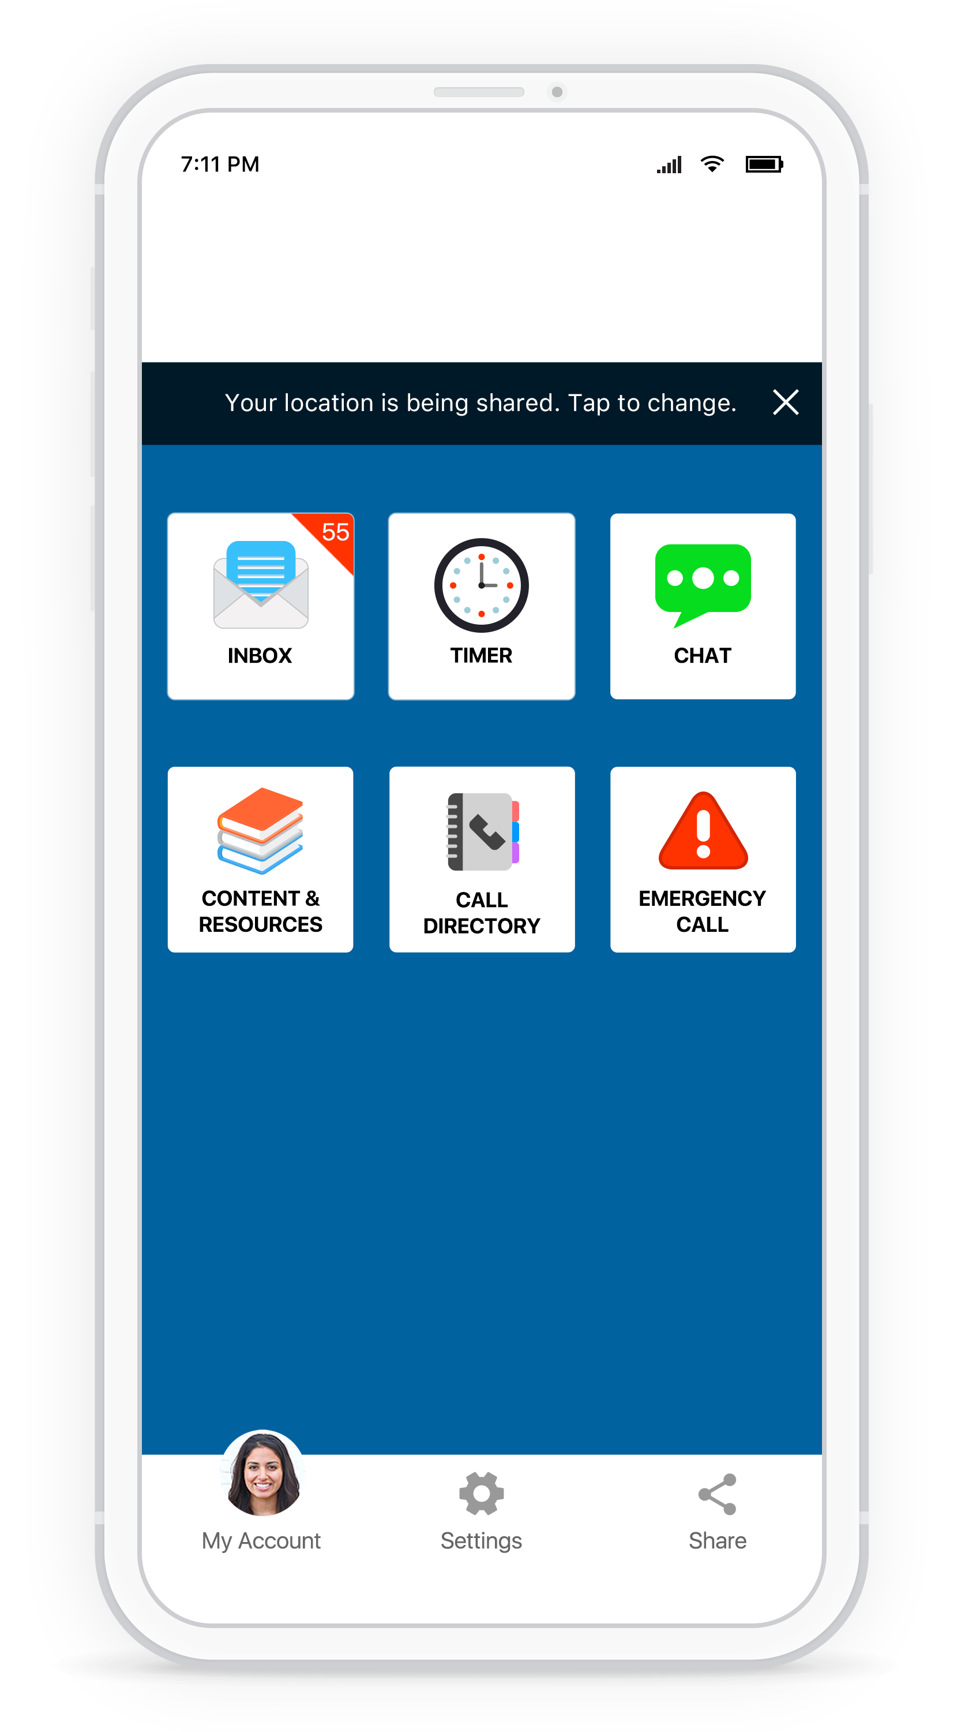
STAY CONNECTED
Receive geo-targeted alerts and access safety resources with the Rave Guardian app.
Visit the app store and search "Rave Guardian" to download and sign up with your email address to access the help and resources you need to stay safe.­
PLACE LOGO HERE

