Slide 1
RAVE GUARDIAN MOBILE APP
RAVE MOBILE SAFETY

Slide 2
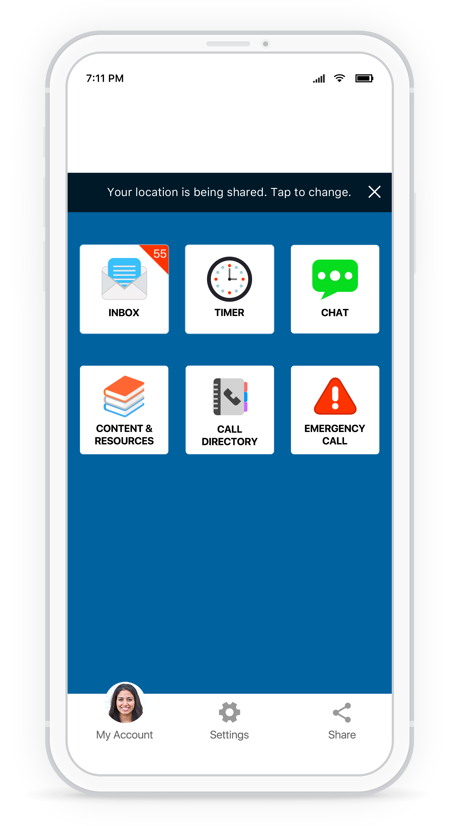






Rave Guardian App features
Inbox
Receive timely campus notifications and updates
Text Campus Police
Two-way communication with optional anonymous mode
Safety Timer
Virtual campus safety escort
Campus Directory
Contact information, hours of operation, address, and more
Campus Content
Important resources, documents, maps, etc.
Emergency Call
One-click emergency dial

Slide 3
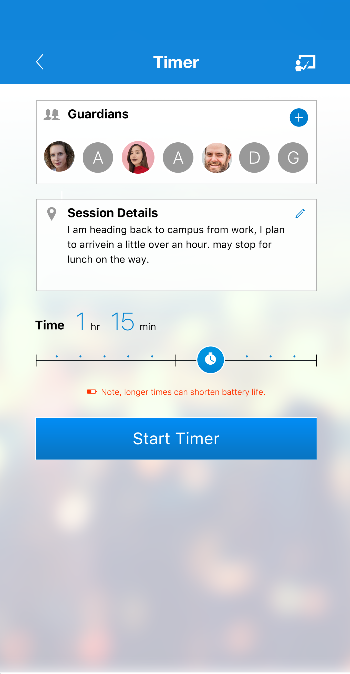
Never Walk Alone
Added layer of safety on-campus & off-campus
Off-Campus Housing, Spring Break, Study Abroad
Activate the Safety Timer and choose friends and family to watch over you during your walk
Campus Safety officials act as your virtual Guardians and will be alerted if you don’t reach your destination

Slide 4
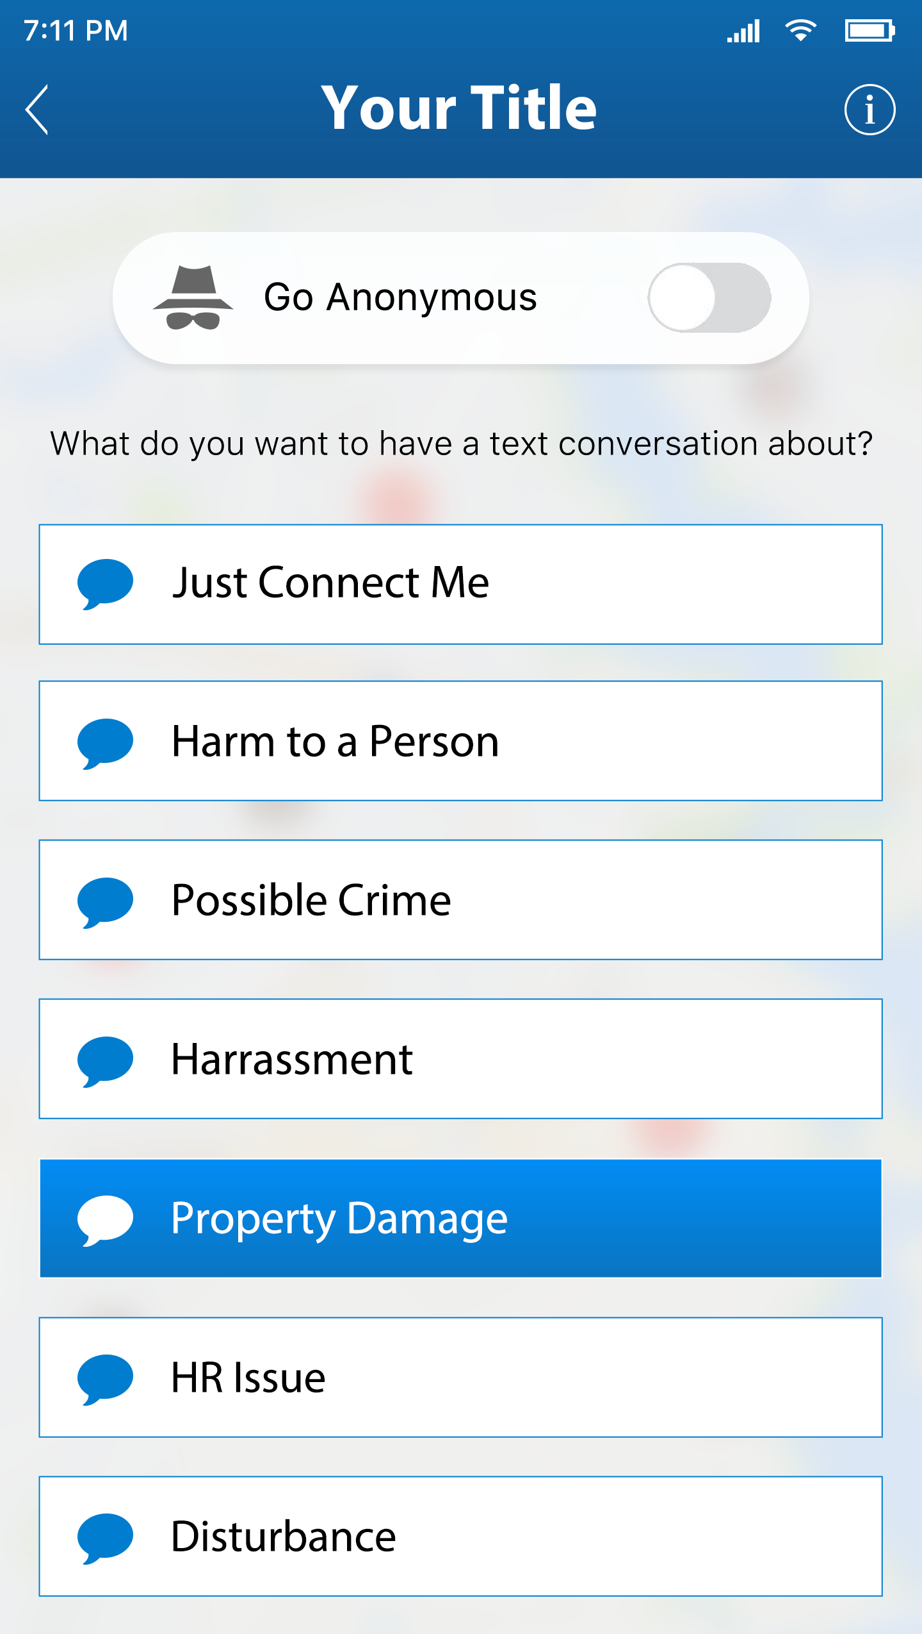
Two-way communication with campus safety
Engage in two-way communication with campus safety officials on the following issues:
Just Connect Me (General)
Possible Crime
Harassment
Disturbance
Harm to a Person (including mental health emergencies)

Slide 5
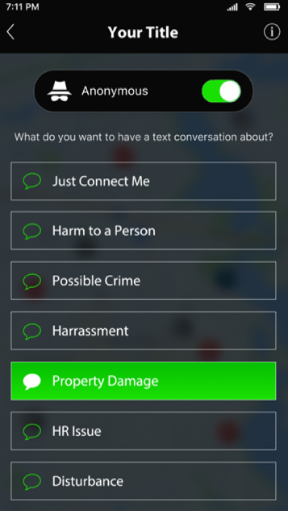
Submit conversations anonymously

Slide 6
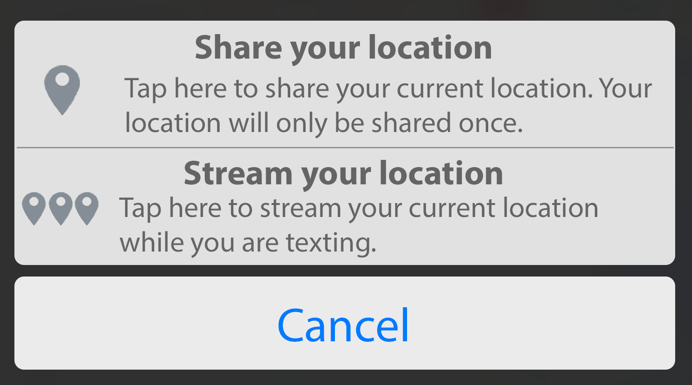
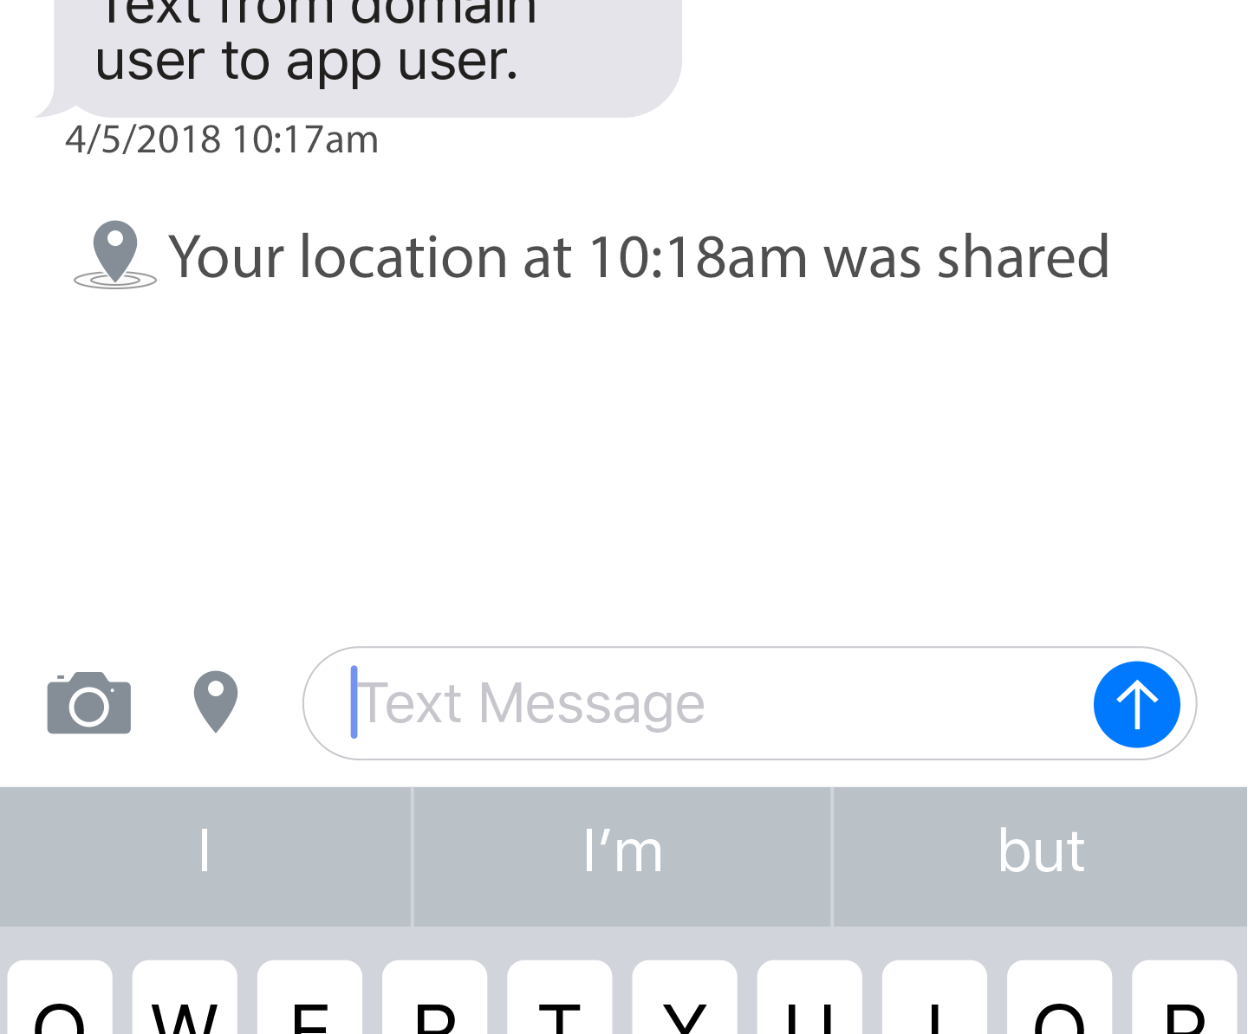
Instant location sharing & STREAMING
With one click, you can share or your location for a faster response – even while in anonymous mode

Slide 7
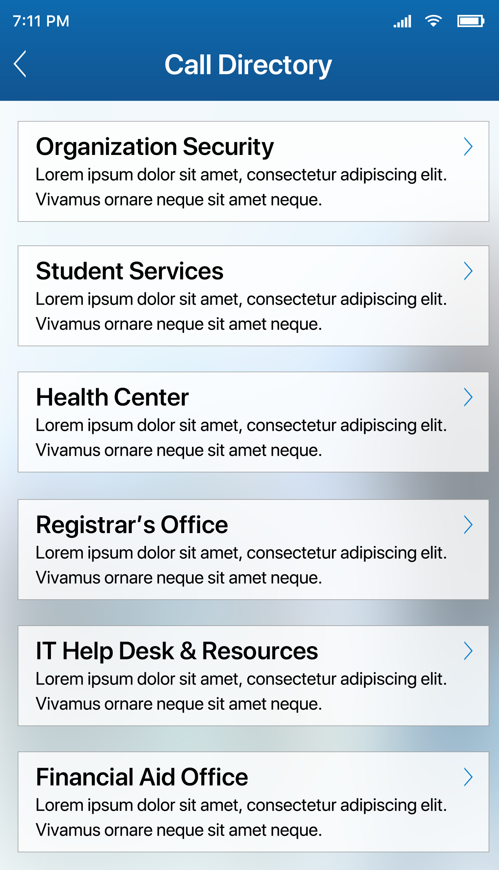
Stay connected with the call directory
Use the Call Directory feature to access the contact information, hours of operation, location and more of offices and departments across campus
Included in the Call Directory:
  Insert office/department name
  Insert office/department name
  Insert office/department name

Slide 8
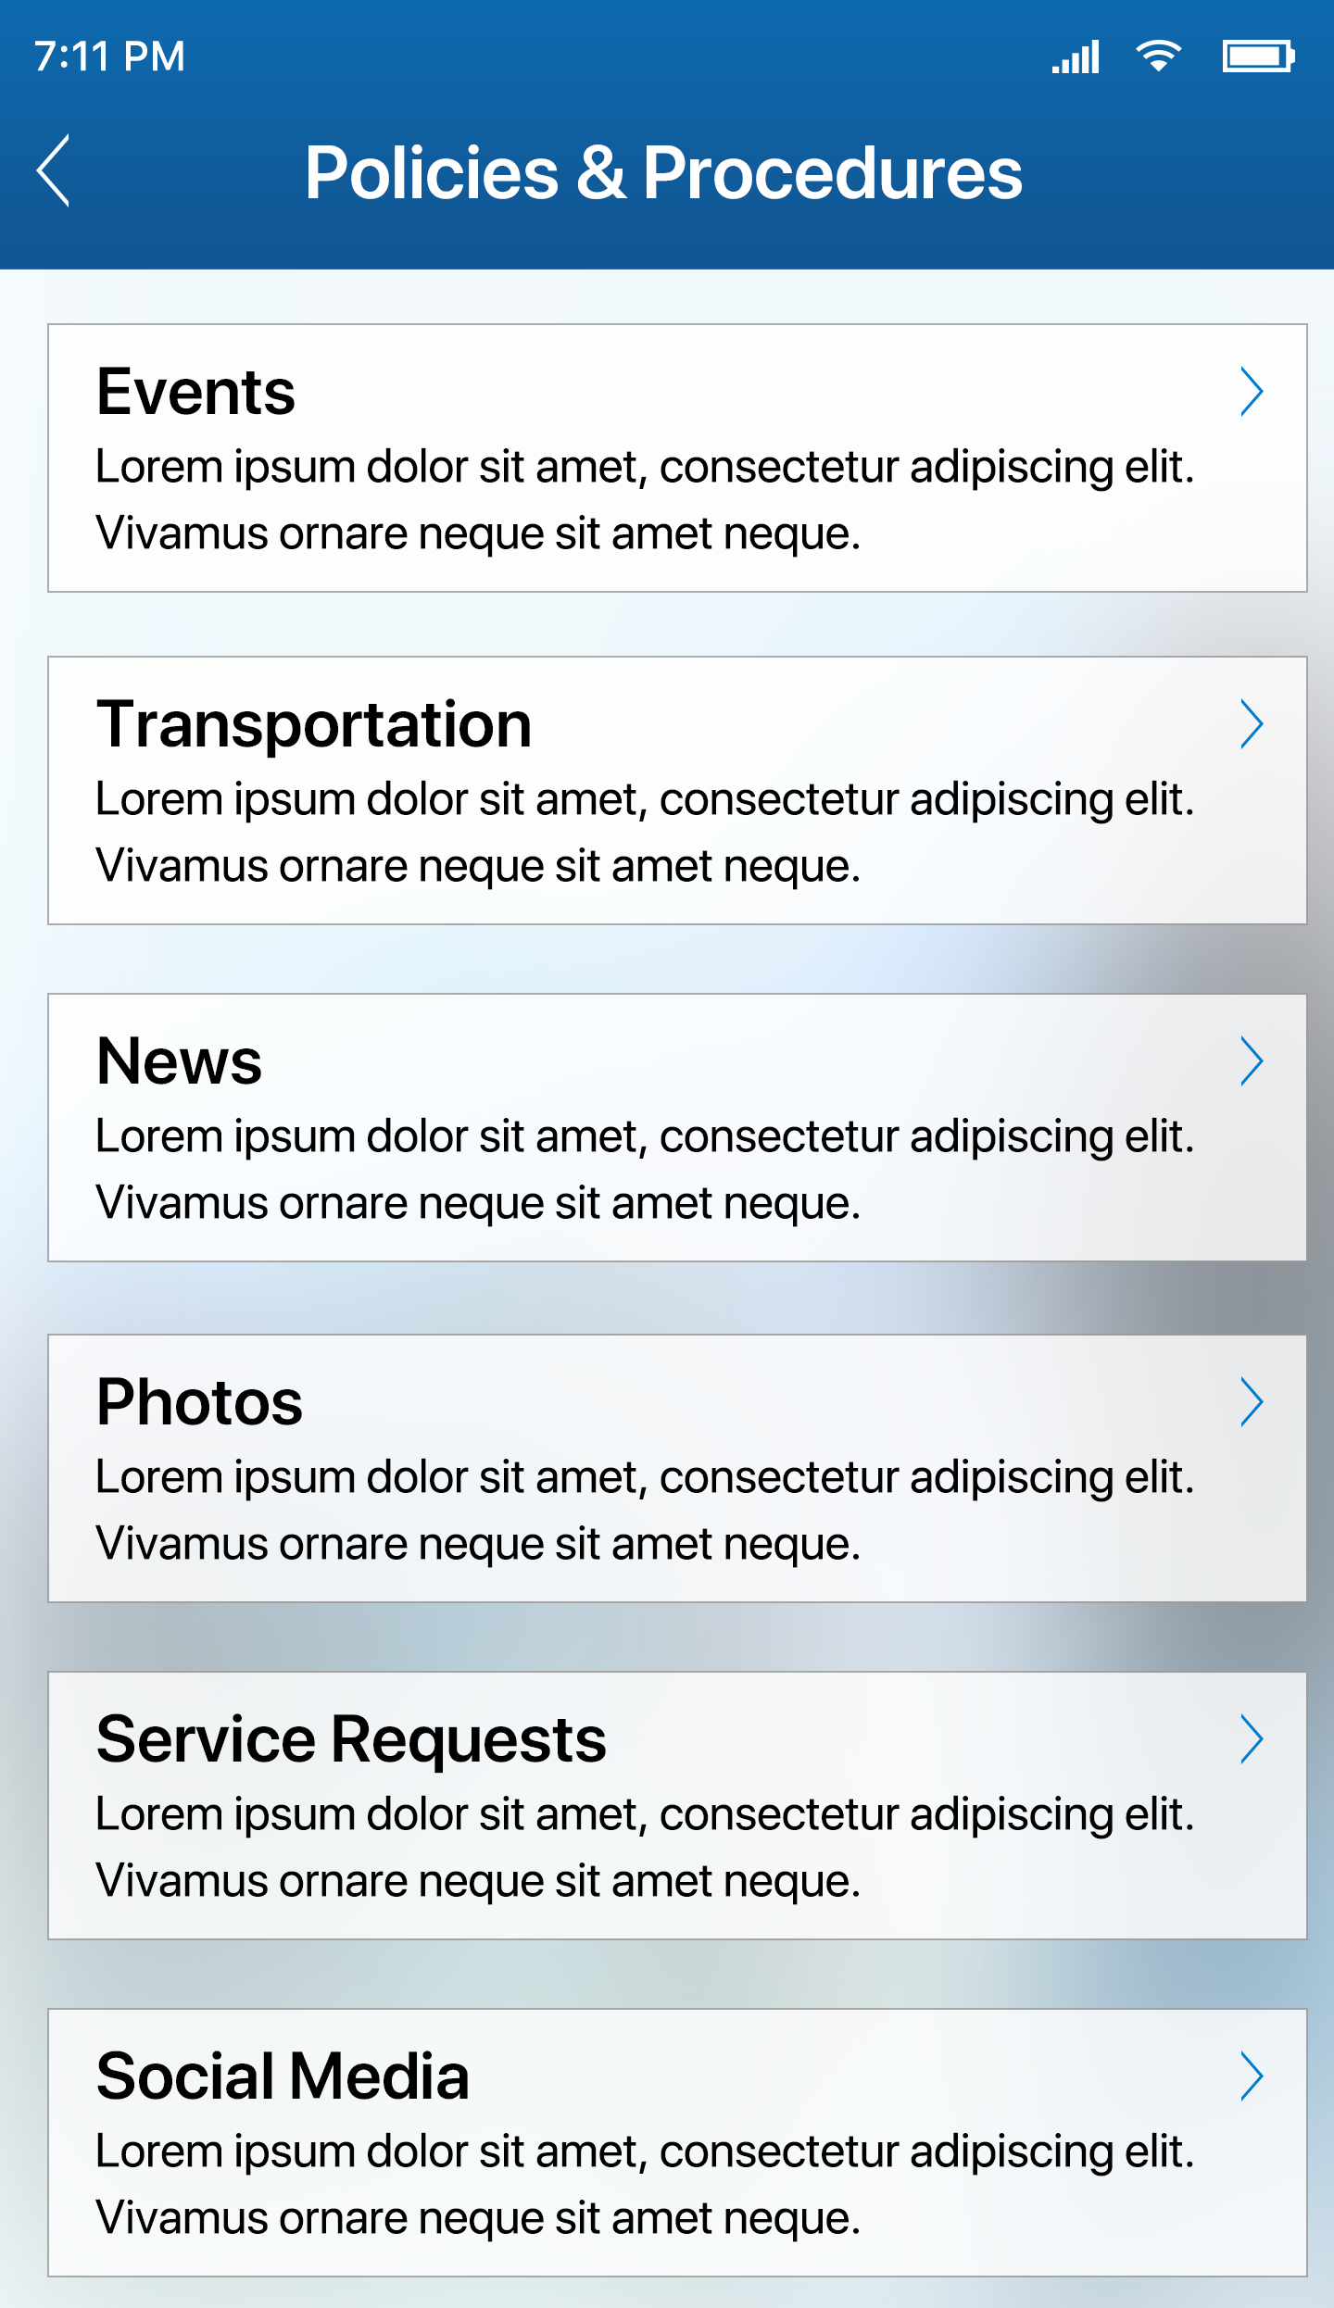
Important campus resources
Access campus information you need to know:
Emergency response plans and safety procedures
Class schedule and academic calendar
Financial aid forms
Campus shuttle/bus schedule

Slide 9
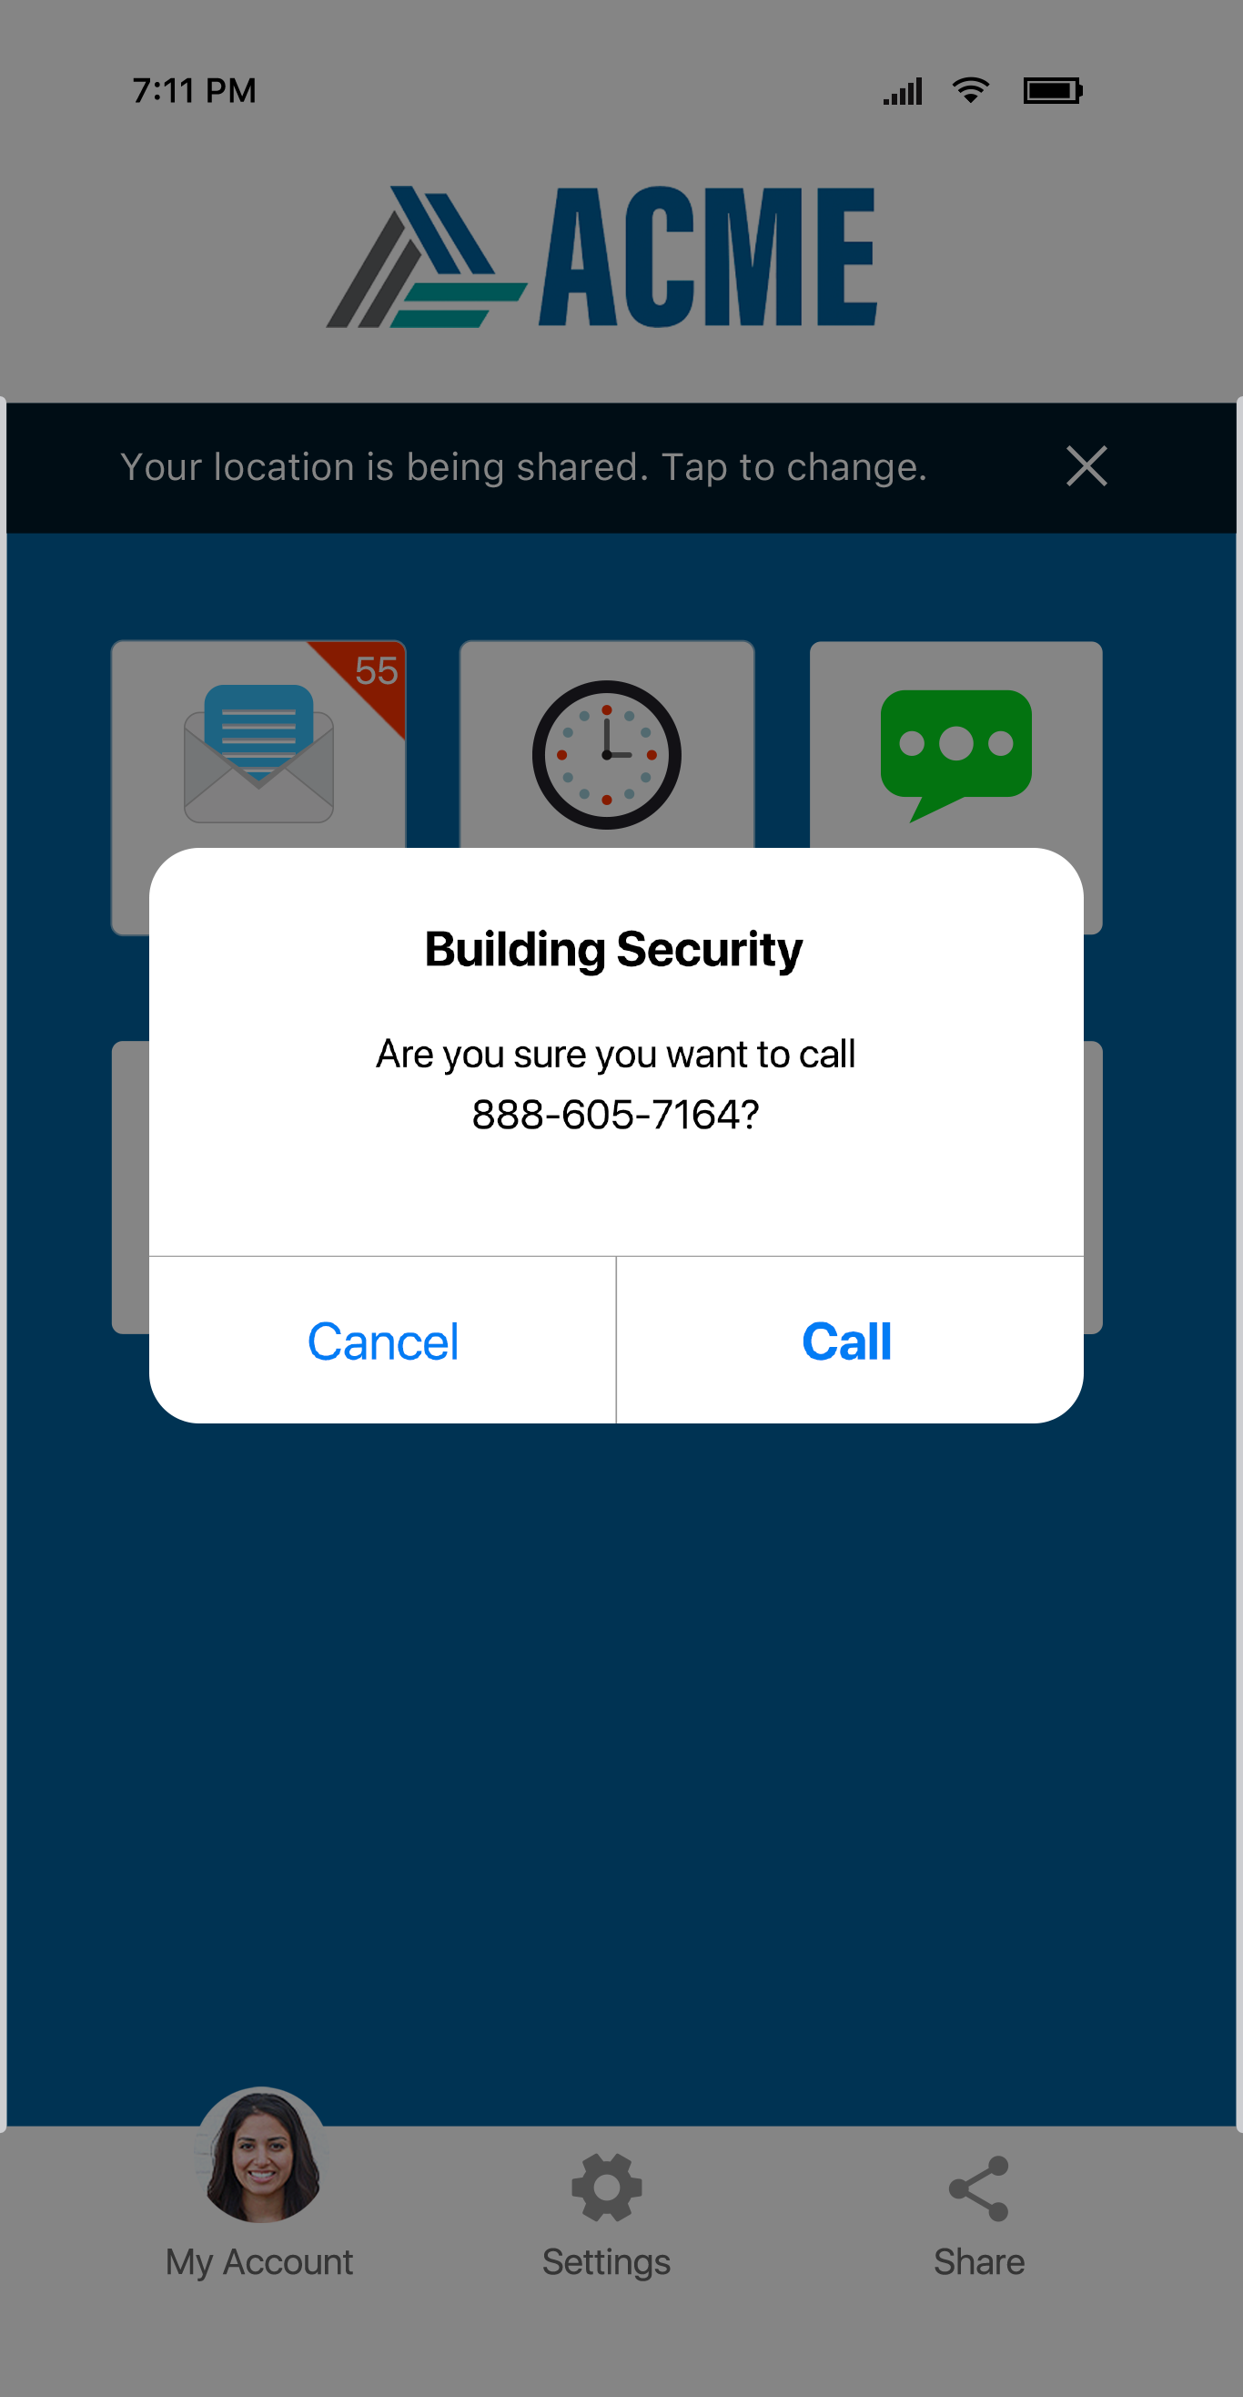
Help is always 1-click away
Use the pre-programmed emergency call button if you need help during an emergency
Connect with campus safety officials with just one click
A confirmation screen (left) ensures you do not dial the emergency line accidently

Slide 10
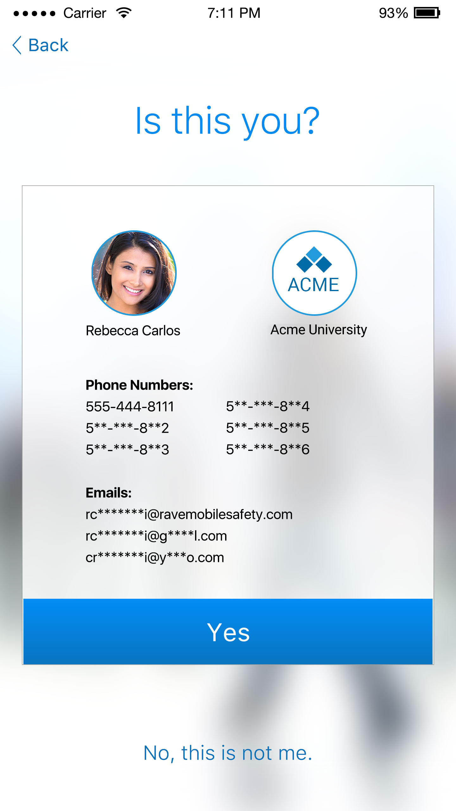


Get started today
Signing up is a quick and simple 2-step process
Download the Rave Guardian Mobile App from the Apple Store or Google Play

Slide 11
Thank you.

