Slide 1

Save PowerPoint slides as an image or PDF:
There may be occasions when you will want to export/save a particular PowerPoint slide(s) as an image file or PDF.
Example you might want to create a high-resolution for social media or website or provide a PDF copy.
Format Types you can save:
PNG
JPEG
GIF (Graphics Interchange Format)
PDF
We recommend using a PNG if your slide contains graphics and a JPEG if you slide contains real-life imagery from a camera.
Here are the steps to saving a selected slide as an image:
Go To File
Select Save As in the left-hand pane
Select your desired File Type from the Save As dialog box
Click Save
Select from the Prompt if you want to save All Slides or the Active Slide
MARKETING SUPPORT REQUESTS
To speak to a member of our team, email us here.

Slide 2


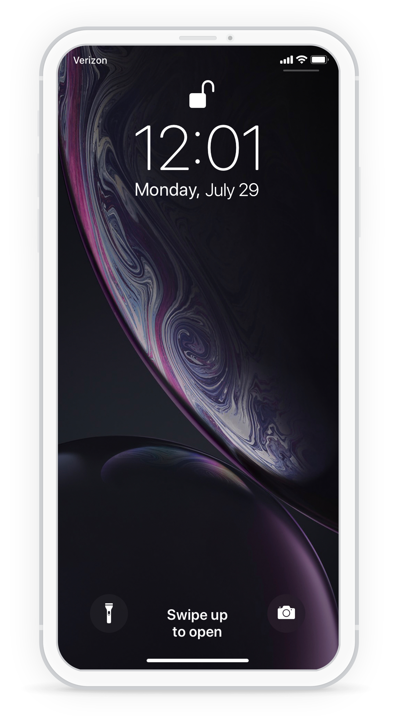


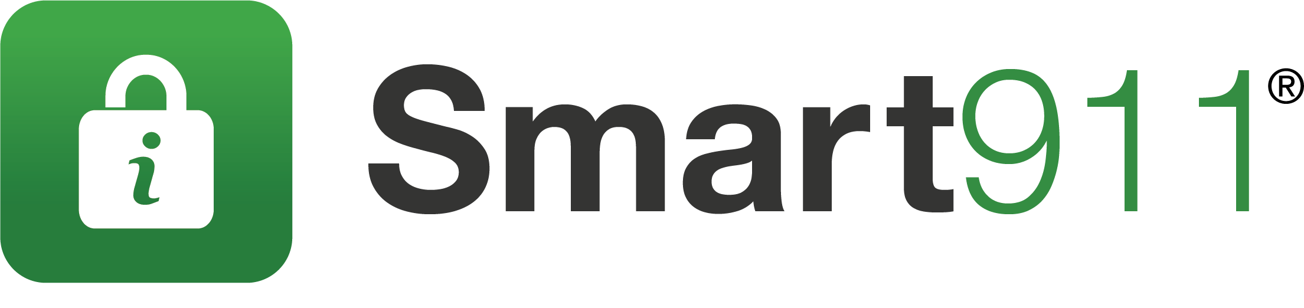
Stay Informed by signing up to receive alerts and notifications via:
INSERT AGENCY INFO
ALWAYS BE NOTIFIED
Second Matter in an emergency
Protect your loved ones by signing up <AlertSystemName> to receive important community and weather alert.
PHONE
TEXT
INSERT AGENCY LOGO
Customize this message for your org. Thank you for signing up for [ORG NAME] alerts to stay informed and up to date.
EMAIL
SOCIAL
INSERT AGENCY WEBSITE
CONTACT INFO
Sign up now!
<website>
POWERED BY:
INSERT AGENCY LOGO

Slide 3

What is Alerts powered by Smart911[or insert your alert system name]?
Alerts powered by Smart911[or insert your alert system name] is the [insert your location]’s official emergency alert and notification system. This system is used to send alerts to the public during emergencies. Alerts powered by Smart911 [or insert your alert system name] is a free service that allows you to sign up online to receive customized alerts via text message, email, and voice message.
In addition to emergency alerts, you can also choose to receive customizable community notifications. These include notifications about severe weather, safety, health, utility disruptions, major traffic incidents, and more. This service is provided by the [insert your location] at no cost to the public; however, message and data rates may apply.
Why should I sign-up for Alerts powered by Smart911 [or insert your alert system name]?
When emergencies happen, be the first to know. The [insert your location] uses Alerts powered by Smart911 [or insert your alert system name] to send official, real-time alerts to the public with information about potentially life-saving actions they may need to take to keep themselves and their families safe. By signing up for Alerts powered by Smart911 [or insert your alert system name], you are taking a large step toward improving your personal safety.
How do I sign-up for Alerts powered by Smart911 [or insert your alert system name]?
Signing up for Alerts powered by Smart911 [or insert your alert system name] is easy! Go to alerts.smart911.com [or insert your custom URL] and register your contact information.
To update your existing Alerts powered by Smart911 [or insert your alert system name] preferences, click here. [insert sign in URL]
Will my information be disclosed or shared?
No, your information is private and will not be used or distributed in any manner. The information that you provide is exempt from public disclosure and will be used for emergency purposes only.
How much does it cost?
This service is provided by the [insert your location] at no cost to the public; however, message and data rates may apply depending on your provider and phone services.
What types of alerts will I receive?
Emergency alerts are sent 24/7 when there is an immediate threat to life and/or property. In addition to emergency alerts, you can also choose to receive customizable community notifications. These include notifications about:
Severe
Safety risks
Health risks
Transportation disruption
Special event information
Test messages
POWERED BY:

