Slide 1
Rave facility
How to drive Facility Profile creations in your community

Slide 2
Agenda
Rave Facility Review (What, Who, Why)
Available Resources
Strategies for Profile Creation
Questions?

Slide 3
What is rave facility?
Facility Profile Can Include:
Multiple buildings within a campus
Point(s) of contact on site
Fire alarm contact
Security alarm contact
Property owner contact information
Gates or access codes
Geographical boundaries including parking lots
Floor plans of each building
Landline phone numbers within a building

Slide 4
Who is the target audience?
Local facility owners and administrators of business, government, healthcare or educational organizations are ideal candidates
Top Rave Facility Users:
Schools
Hospitals or Medical Centers
Strip Malls or large retailers
Hotels
Large corporations or corporate office parks

Slide 5
Why should they create a profile?
Whether it is an employee, customer, or visitor in a location, having the information to reach their exact location within the facility as well as access points and floor plans can cut seconds and minutes off the response time.
Specific Use Cases:
Fire
Medical Emergency
Active Shooter or other incident

Slide 6
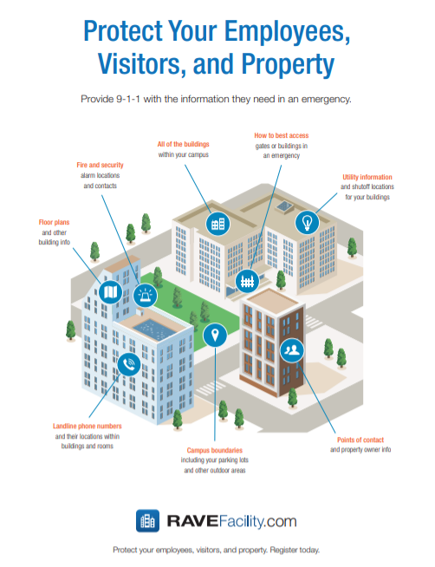
Outreach Materials
Tri-fold Brochure
Flyers and Two-sided Handouts
IMG
(if desired)
Business Card
Social Media Graphics/Web Badges
Facility Window Decals (once complete)
To access these resources, click here.
Notes:
These resources can be accessed via the Rave Marketing Portal at https://www.ravemobilesafety.com/support/rave-marketing-portal/facility-marketing/

Slide 7
Outreach strategies
Existing Organization
Outreach is KEY
Start w/ public properties, then move to private facilities
Government buildings, libraries, parks, schools, pools, etc.
Email Templates
Access Templates Here
New Organizations
Require each applicant for a business license to provide the Office of Buildings (or equivalent) proof of Facility Profile creation
Business Licensing Ordinance Template
Access Template Here
Notes:
Use when there are a lot of bullets and no need for images. Breaking up the bullets in two columns helps readability.

Slide 8
Thank you!
Questions?
Notes:
Presentation title slide contains title, subtitle, and optional author info.
Background can be customized to fit specific subject matter upon request.

