Slide 1
Save PowerPoint slides as an image or PDF:
There may be occasions when you will want to export/save a particular PowerPoint slide(s) as an image file or PDF.
Example you might want to create a high-resolution for social media or website or provide a PDF copy.
Format Types you can save:
PNG
JPEG
GIF (Graphics Interchange Format)
PDF
We recommend using a PNG if your slide contains graphics and a JPEG if you slide contains real-life imagery from a camera.
Here are the steps to saving a selected slide as an image:
Go To File
Select Save As in the left-hand pane
Select your desired File Type from the Save As dialog box
Click Save
Select from the Prompt if you want to save All Slides or the Active Slide
MARKETING SUPPORT REQUESTS
To speak to a member of our team, email us here.

Slide 2
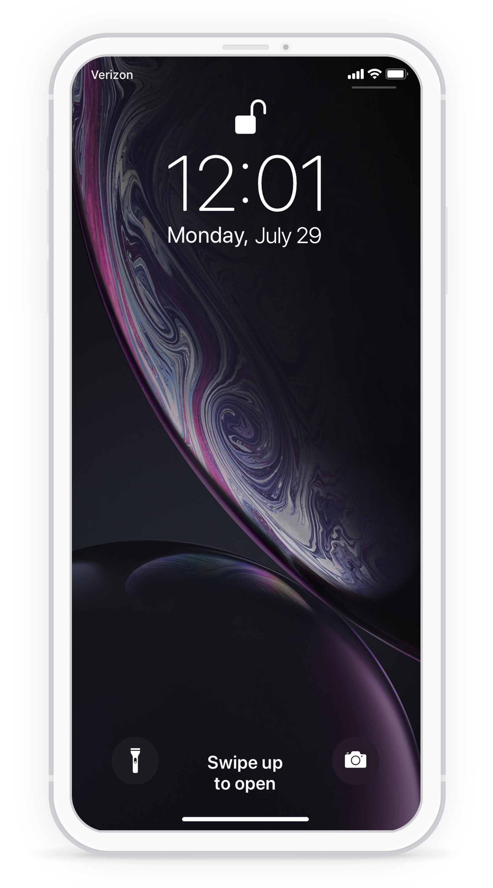
Are you prepared for
a FLOOD?
Sign up for [COMPANY] alerts and receive important notifications via text message.
Customize this message for your org. Thank you for signing up for [ORG NAME] alerts to stay informed and up to date.
Logo
POWERED BY:

Slide 3
Are you prepared for
a BLIZZARD?
Sign up for [COMPANY] alerts and receive important notifications via text message.
Customize this message for your org. Thank you for signing up for [ORG NAME] alerts to stay informed and up to date.
Logo
POWERED BY:

Slide 4
Are you prepared for
a EARTHQUAKE?
Sign up for [COMPANY] alerts and receive important notifications via text message.
Customize this message for your org. Thank you for signing up for [ORG NAME] alerts to stay informed and up to date.
Logo
POWERED BY:

Slide 5
Are you prepared for
a WILDFIRE?
Sign up for [COMPANY] alerts and receive important notifications via text message.
Customize this message for your org. Thank you for signing up for [ORG NAME] alerts to stay informed and up to date.
Logo
POWERED BY:

Slide 6
Are you prepared for
a HURRICANE?
Sign up for [COMPANY] alerts and receive important notifications via text message.
Customize this message for your org. Thank you for signing up for [ORG NAME] alerts to stay informed and up to date.
Logo
POWERED BY:

Slide 7
Are you prepared for
a TORNADO?
Sign up for [COMPANY] alerts and receive important notifications via text message.
Customize this message for your org. Thank you for signing up for [ORG NAME] alerts to stay informed and up to date.
Logo
POWERED BY:

