Slide 1
RAVE ALERT & RAVE GUARDIAN ORIENTATION SLIDES
v2

Slide 2
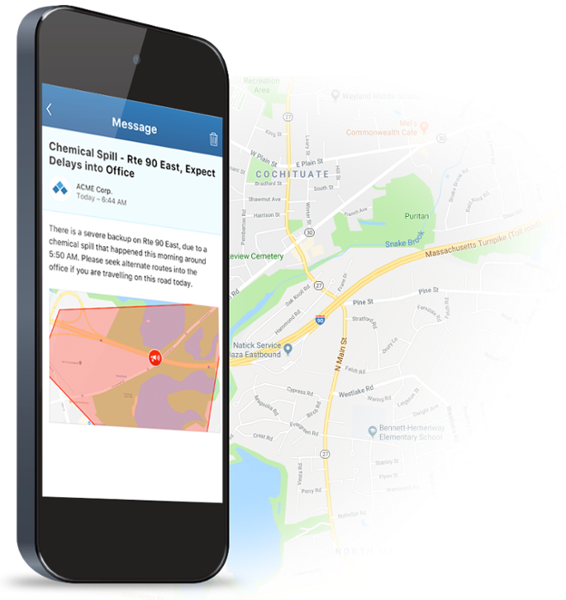
New & improved alerts
We will be offering a faster, more reliable, more efficient emergency notification system. Because we value your safety, you have been automatically enrolled.
You man opt-out at any time.

Slide 3
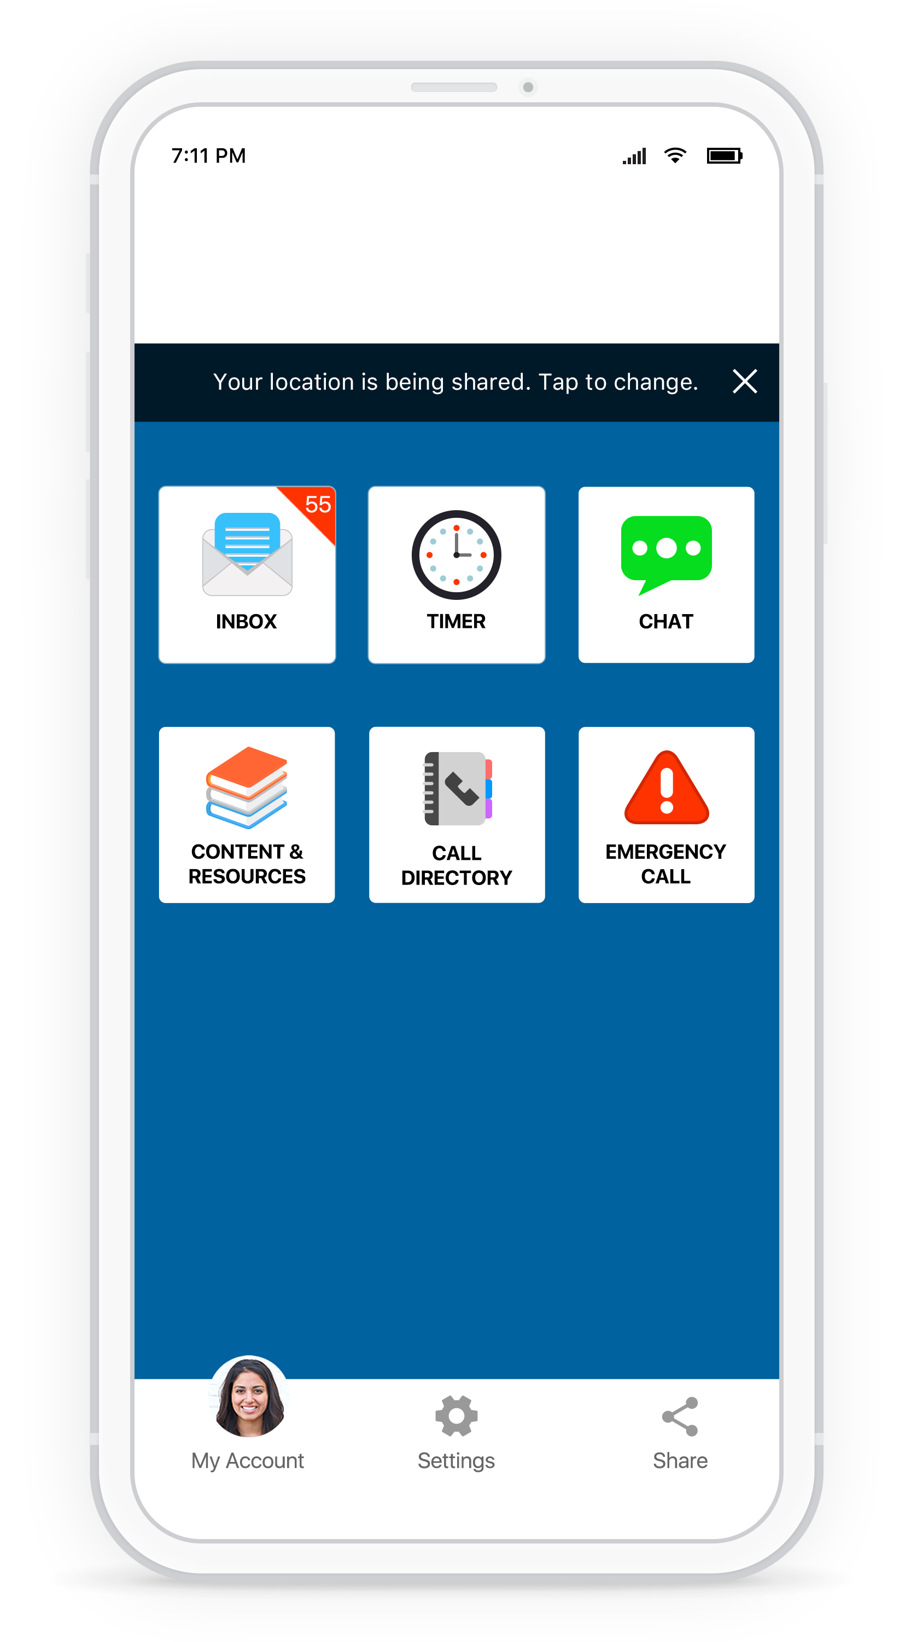
Stay connected
Download the Rave Guardian app for safety resources and to receive alerts relevant to your location.
Search “Rave Guardian” in the app store and sign up in two steps for the help and resources you need to stay safe.

Slide 4
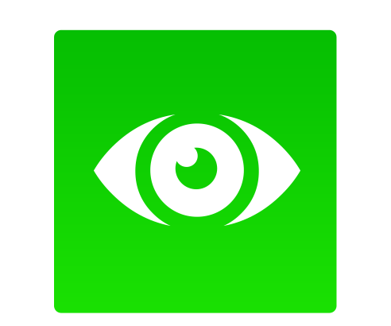
Your mobile safety app
Discreetly contact security: Discreetly send anonymous tips
Stay informed: Receive alerts based on your location
Never travel alone: Travel with a virtual escort to monitor safety
Find the resources you need: Access emergency procedures, schedules and other key documents
Make the right call: call directory of your organization’s numbers
Help is on the way: Directly connect to 9-1-1 or Security

Slide 5
HOW TO DOWNLOAD RAVE GUARDIAN
Search “Rave Guardian” in the app store
Click to install and enter your phone number and verification code
Enter your email address
Select to share you location for geo-targeted alerts and localized content

