Slide 1
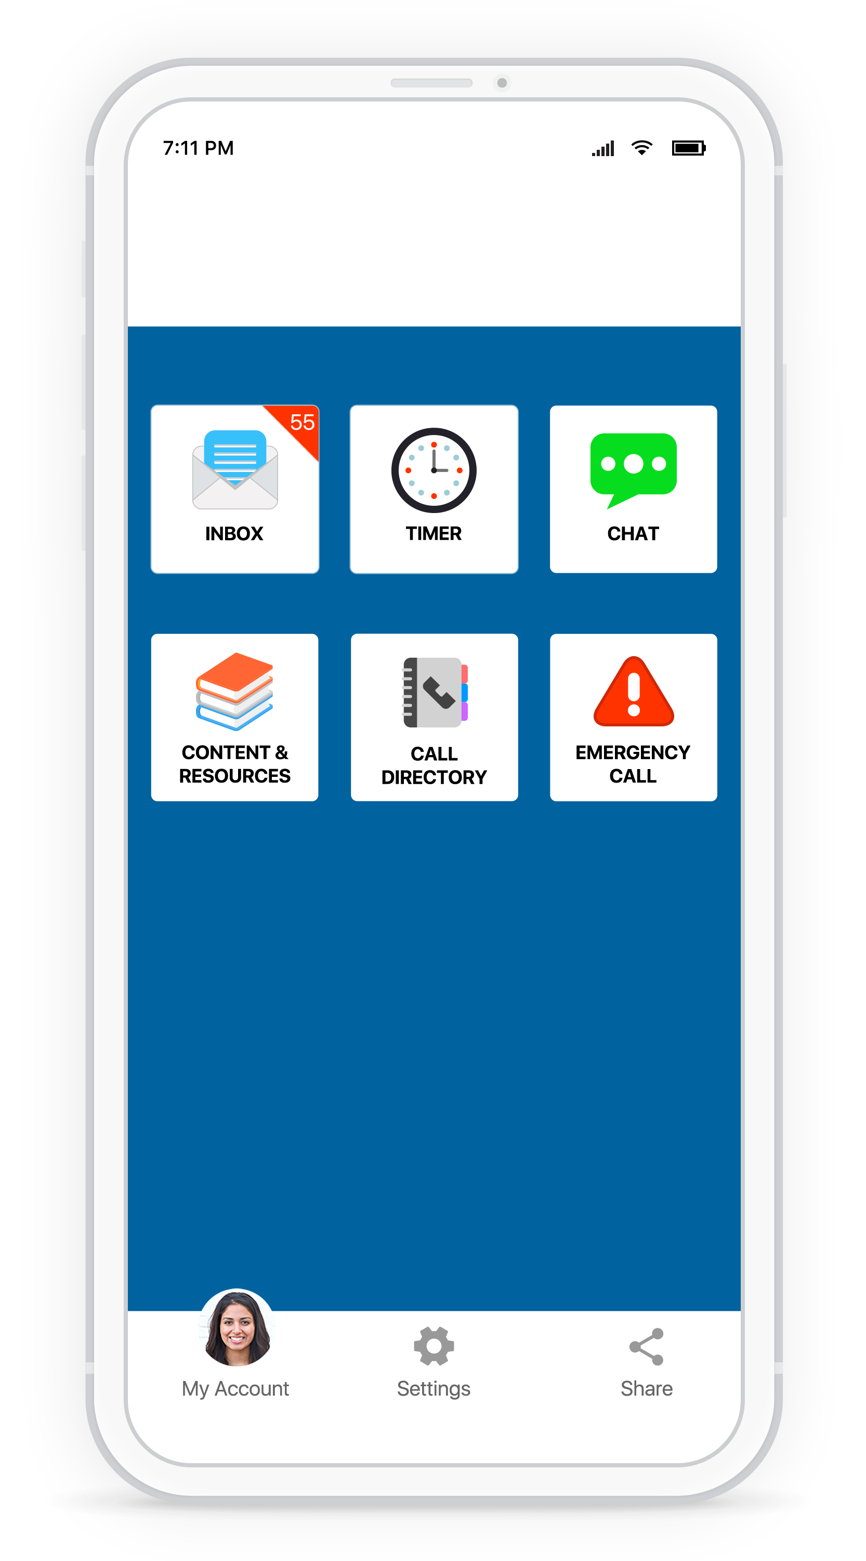


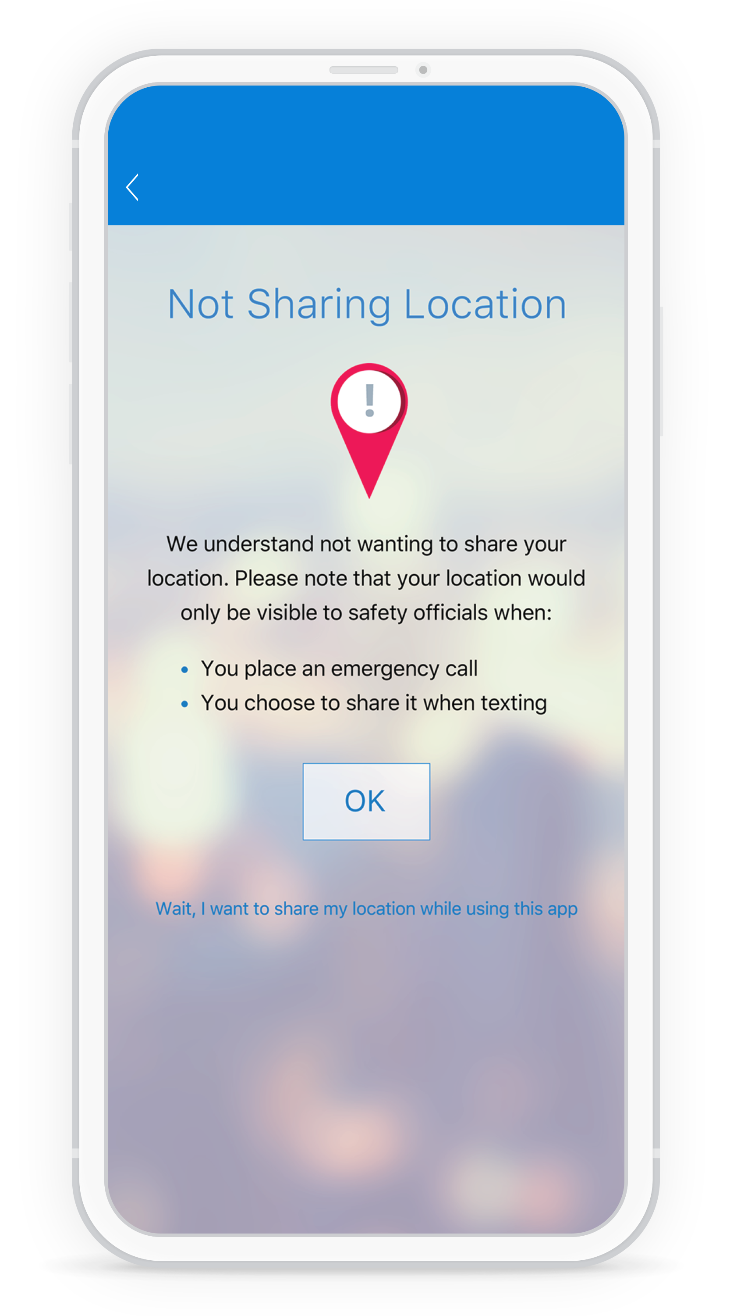







How
RAVE GUARDIAN
Works:
WE CARE ABOUT YOUR PRIVACY
With Rave Guardian, you choose what information you want to share. You can share your location to receive geo-targeted alerts and faster response to an emergency call. However, you do not need to share your location or other personal information to use the app. You can access resources and submit tips even without your organization knowing who or where the information is coming from.
Any information you enter into the app is housed in top-tier secure facilities complete with 24/7 physical security, video surveillance, and alarms. The facilities and applications are regularly audited and subjected to intrusion prevention testing. We utilize the same secure sockets layer (SSL) certificate authority and encryption technologies used by leading financial institutions.
1
Download “Rave Guardian” in the Apple or Google Play store.
2
Enter your email address and phone number to join your school’s customized Rave Guardian app.
STAY CONNECTED
AND SAFE
3
Access the tools and resources customized for your school.
No matter the situation you are in, your school is two clicks away and can provide the help and resources you need through the Rave GuardianTM app.
DOWNLOAD RAVE GUARDIAN TODAY.
www.raveguardian.com

Slide 2
HELP & RESOURCES
ARE JUST ONE CLICK AWAY
There’s a party going on down the hall. It’s getting very loud and I’m trying to study.
NEVER TRAVEL ALONE
Set a virtual safety timer for an extra layer of safety wherever you are.
Thank you for reporting this.
Your tip will remain confidential.
Can you please tell me what
building you are in?
DISCREETLY CONTACT CAMPUS SAFETY Prevent dangerous situations by discreetly sending anonymous tips with a photo or location as needed.
Founder’s Hall, second floor.
We will send someone
over immediately.
STAY INFORMED
Received alerts based on your location, even when you don’t have a cell signal
HELP IS ON THE WAY
With a push of a button, you can directly connect to 9-1-1 or campus safety in an emergency.
See Something,
Text Something
When you need to contact campus safety, you don’t want people overhearing.
Rather than risk not reporting a loud party, someone who drank too much or suspicious character, submit a text message directly to campus safety or other key departments.
Only they will see the tip, and your tip will be confidential for ultimate discretion.
FIND THE RESOURCES YOU NEED
Access emergency procedures, schedules and other key documents in a custom content portal.
MAKE THE RIGHT CALL
Easily find assistance and resources with a custom call directory of your organization’s important numbers.

