Slide 1
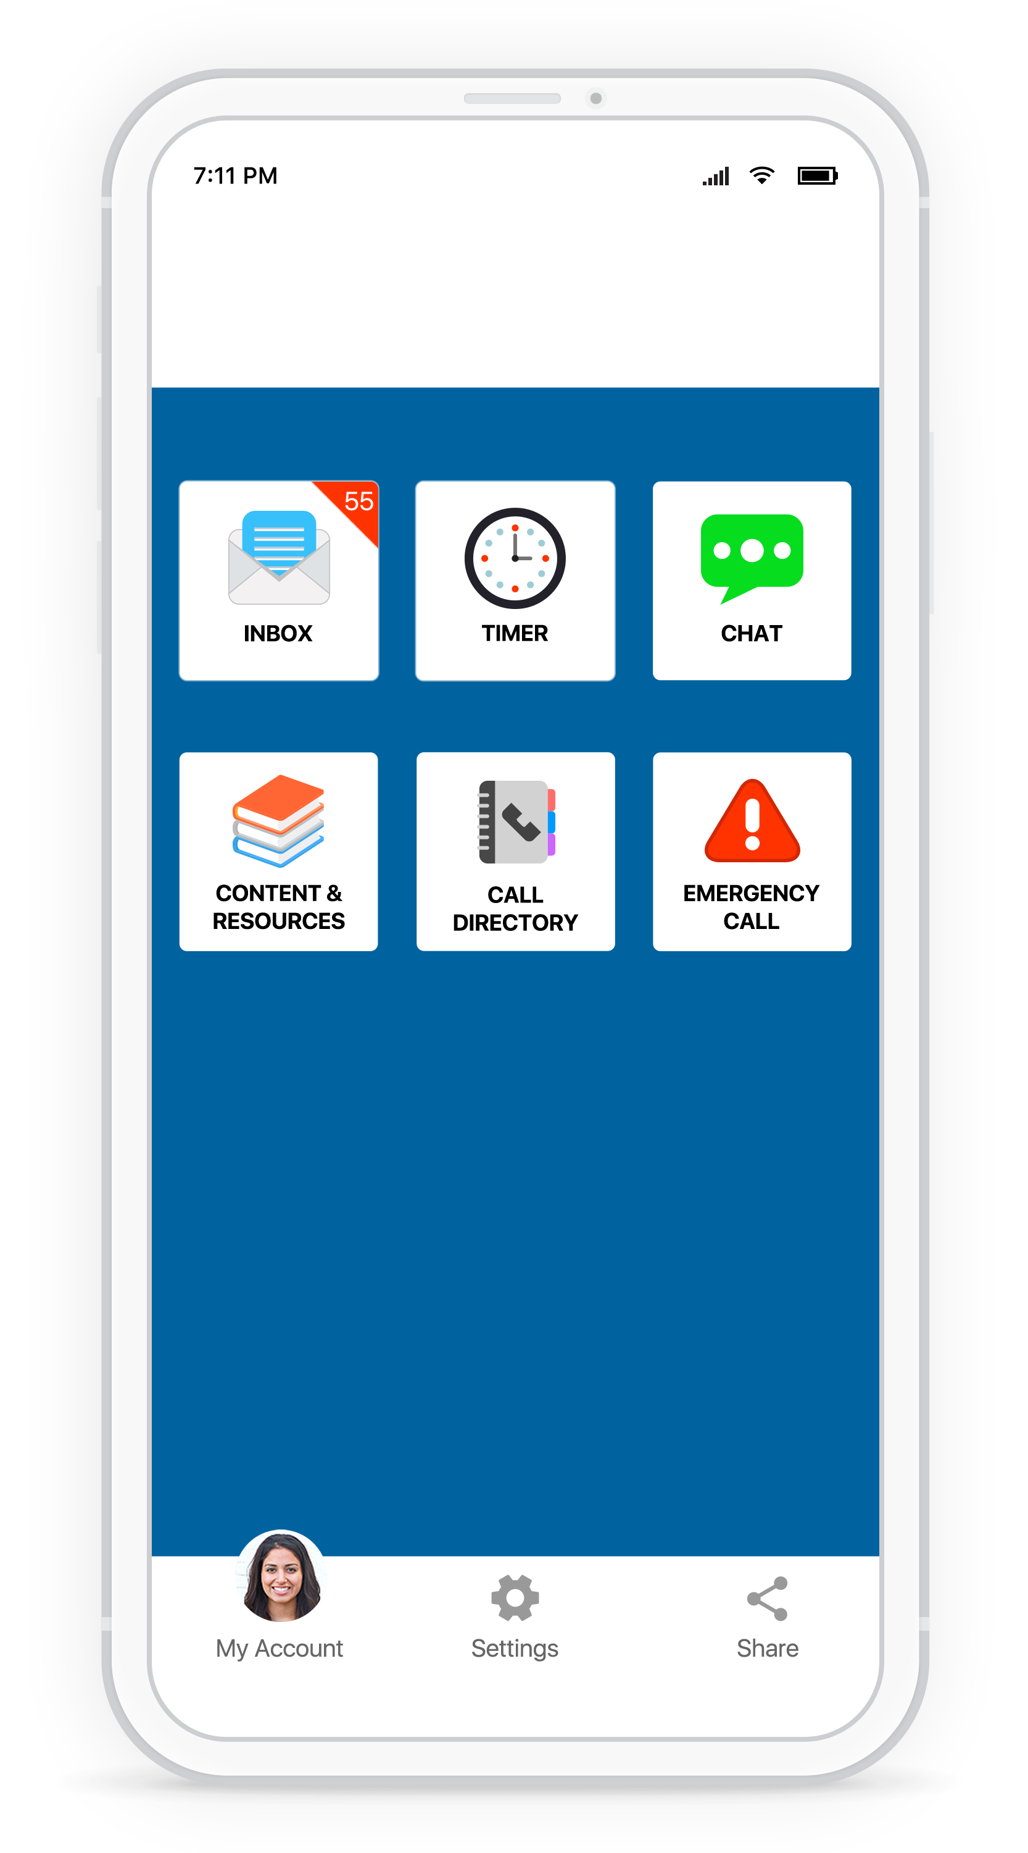



STAY CONNECTED AND SAFE
No matter the situation you are in, your school is two clicks away and can provide the help and resources you need through the Rave Guardian™ app.
DOWNLOAD RAVE GUARDIAN TODAY.

Slide 2

STAY CONNECTED AND SAFE
No matter the situation you are in, your school is two clicks away and can provide the help and resources you need through the Rave Guardian™ app.
DOWNLOAD RAVE GUARDIAN TODAY.

