Slide 1

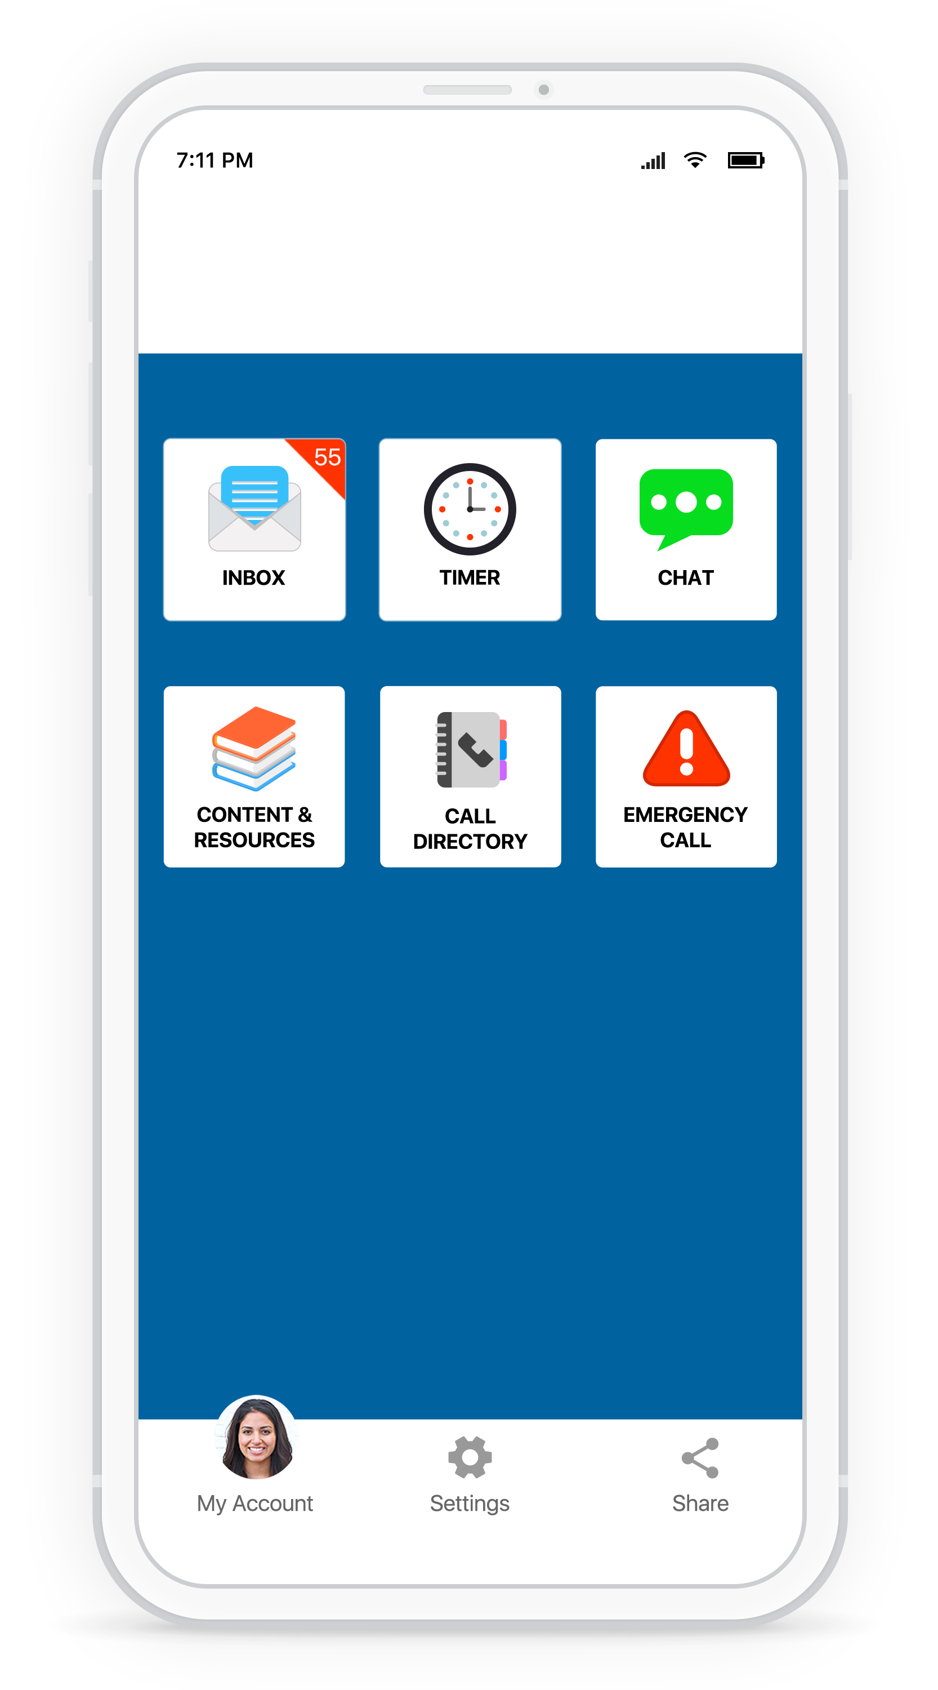


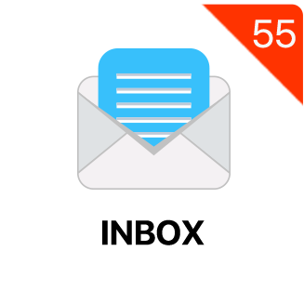







Now Your Phone Can Keep You Safe and Help Protect Your Friends
Your Logo
Help & resources are just one click away with the Rave Guardian™ personal safety app
NEVER TRAVEL ALONE
Set a virtual safety timer for an extra layer of safety wherever you are.
DISCREETLY CONTACT CAMPUS SAFETY Prevent dangerous situations by discreetly sending anonymous tips with a photo or location as needed.
STAY INFORMED
Received alerts based on your location, even when you don’t have a cell signal
DOWNLOAD
RAVE GUARDIAN TODAY!
HELP IS ON THE WAY
With a push of a button, you can directly connect to 9-1-1 or campus safety in an emergency.
FIND THE RESOURCES YOU NEED
Access emergency procedures, schedules and other key documents in a custom content portal.
Scan the QR code now or search Rave Guardian in the App Store.
MAKE THE RIGHT CALL
Easily find assistance and resources with a custom call directory of your organization’s important numbers.
Scan the QR code now or search Rave Guardian in the Google Play Store.
RaveGuardian.com

