Slide 1


Creating Success with Facebook
Boosting Posts

Slide 2
Step 1: Creating & Promoting a Post
The easiest way to advertise on Facebook is to “Promote” or “Boost” a post written to your organizations existing Facebook page.
Only page admins can boost posts
No Facebook page? Now might be a good time to launch one.

Slide 3
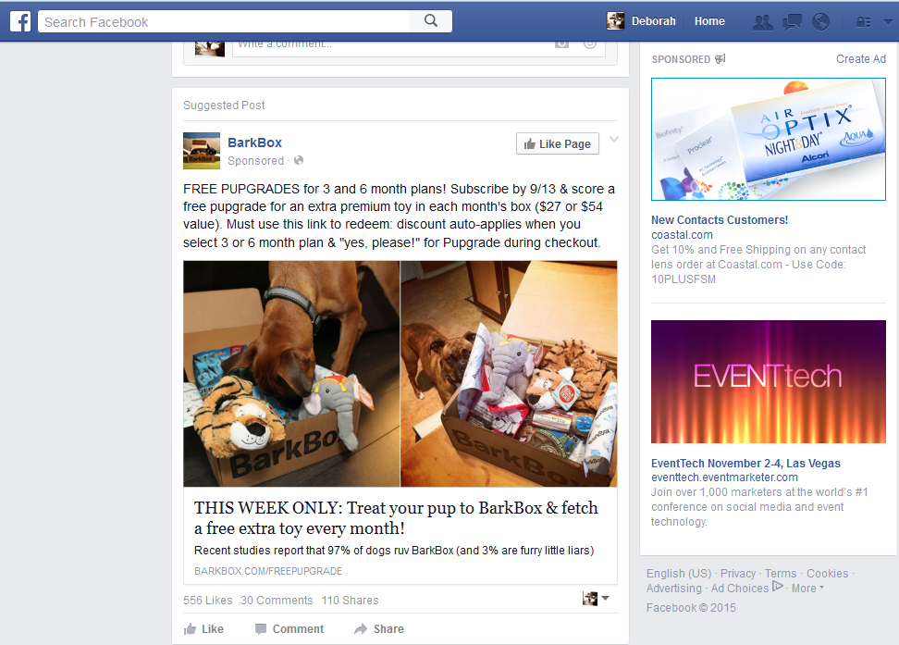
What’s a Promoted Facebook Post?
Your News Feed
Their Message

Slide 4
Suggestions for Writing Your Post/Ad
Decide what you want people to do after seeing the ad
  Sign up for Smart911
Decide where they are going to get more information
  www.smart911.com
Write something that is short, direct, & engaging
Make the call to action clear.
  Create a Safety Profile, Sign up for Alerts, Download the App etc.
Add photos or video links.
Quality counts – put your best foot forward
Make sure you tag @Smart911, so we can share your post!

Slide 5
Post Examples You create A/B tests of different copy to see which has a better response.
Did you know @Smart911 is a free service available to keep your and your family safer? Smart911 lets you create a private and secure safety profile. Help 9-1-1 help you faster: www.smart911.com
Have you signed up for @Smart911? Take some time to create a safety profile to help first responders help you during an emergency. Visit www.smart911.com to sign up today.

Slide 6
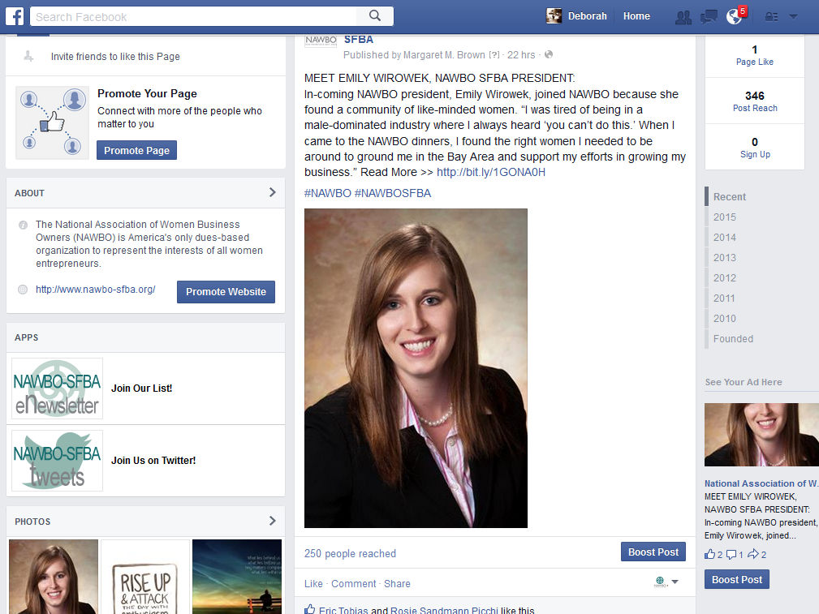
Prepare to Promote the Post
Start Here:
When a page administrator makes a post, they are prompted to boost the post by clicking this button.
The post will be labeled “sponsored” and put directly into the newsfeeds of targeted people.
Not recommended.
You want to promote an invitation, not your entire page. It drives people to like your page, rather than learning to dance.
Not recommended.
This would put your ad into the right hand column.
When was the last time you looked at the right hand column?

Slide 7
Step 2:
Where and Who to Reach

Slide 8
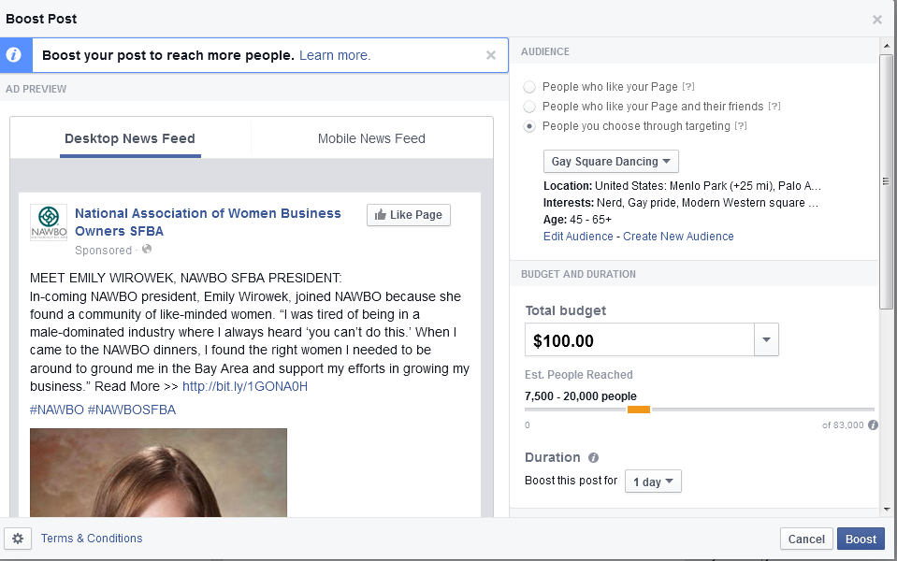
Create the Parameters of your Campaign – Step by Step
Choose “People you choose through targeting
Choose the audience (more on that on the next page)
Set the Budget….the Higher the Budget, the more people you will reach. This is subjective and based on trial/error at first. Start with $50 - $100 for 2 weeks. You can refine the budget as you get results.
Decide the length of the campaign. Recommend 2 weeks minimum. One month would be better.
Review your post in both desktop and mobile versions. If you don’t like it, start over and edit the post
Click Boost and you will be taken to the payment page.
1
5
2
3
4
6

Slide 9
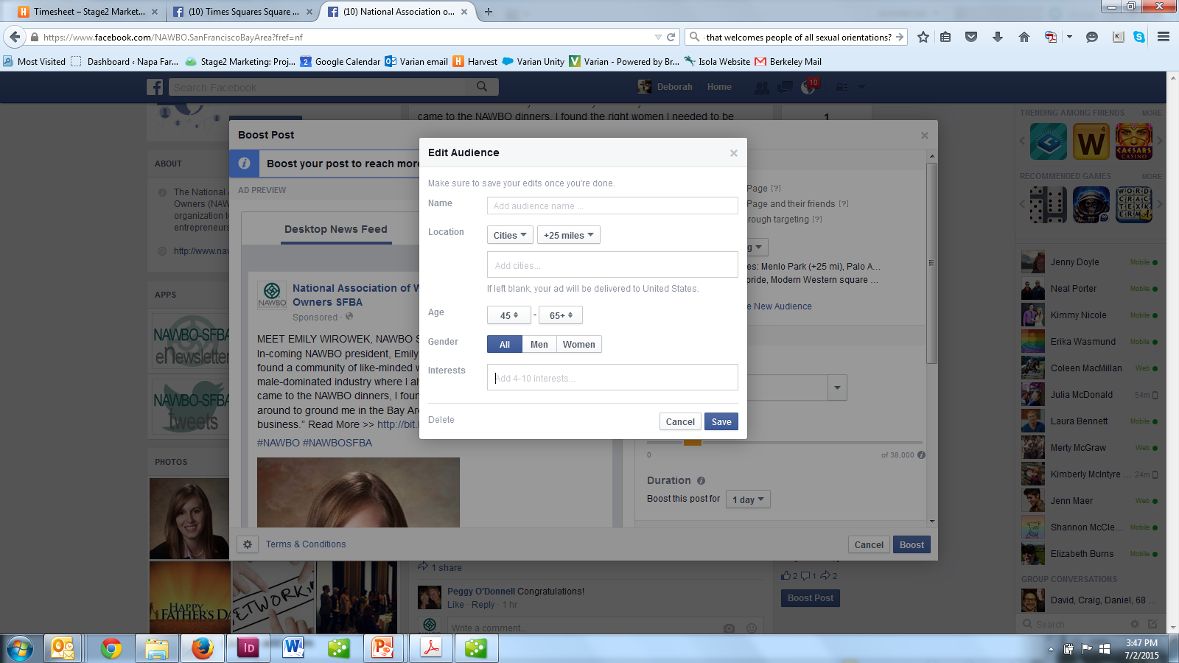
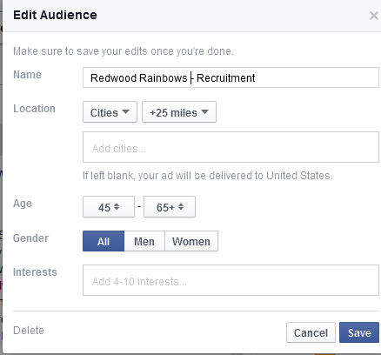
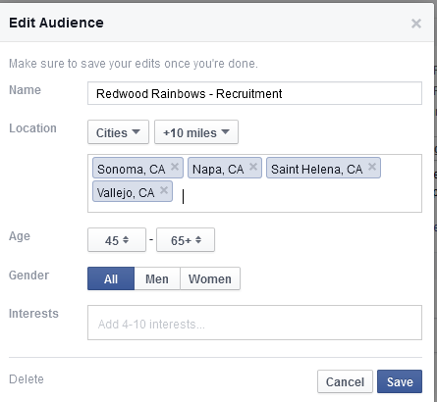
Define the Audience
After you check “People you choose through targeting”, you will be prompted to create a new audience. You will come to this page.
Give the Audience a Name. Example: Residents with Access to Smart911
Decide on the geography of your audience using Location. For this example, I chose 10 miles from Sonoma and its surrounding cities.
Base your choices on the locations of your current residents.

Slide 10
Define the Audience Cont’d
Adjust your age (25-65) and interest preference. Looking to hit a specific demographic? People who follow Safety Interests
Choose your audience’s interests based on your current members interests. Facebook may prompt some additional suggestions.

Slide 11
Audience Size
Audience Size Changes with Budget and Length of Campaign.
  Based on Facebook ad response rates, you want at least 1,000 people for each person you hope to respond to the campaign
    If the goal is 10 new people visit your website, you need at least 10,000 people.
  If your audience is too small, remove some of the interests or look for broader categories
For example, if the budget is $100 for a 7 day campaign using the example audience on pages 8 & 9), Facebook will reach between 5,600 – 15,000 people.
  If we change the budget to $150, we will reach 8,300 to 22,000 people.
    Note: Facebook prompts certain dollar amounts, but you can over-ride them.
Test budget, campaign length and audience description to find the right mix for your organization.

Slide 12
Step 3:
Measuring Success
The goal of a sponsored/boosted Facebook post is to get people to click on your ad.

Slide 13
Facebook is just a step towards engaging residents.
Facebook Ad
Click to Learn More
Your Web Site
Evaluate how well your website meets these criteria
Engaging residents about Safety
Easy to understand
Easy to navigate
Clear directions on how to learn to sign up
Encouraging
Offers an easy way to get questions answered

Slide 14
Step 5:
Best Practices
Facebook makes it easy to test. In the testing, your campaigns will become more effective and fruitful.

Slide 15
Best Practices
Send viewers to your website/Smart911, rather than Facebook page. It moves them closer to signing up.
Send viewers to a specific page on your organization’s website…dedicated to telling them what they need to know about your safety service. Make it easy for them.
Target the audience most likely to sing up for your safety service instead of the audience you want to sign up for your safety service.
Spend enough money and run the campaign long enough to make a difference.
  If it is not working after a week, test a different post or audience. Do not pull the advertising after a few days.
Test geographies, interests and budgets.

Slide 16
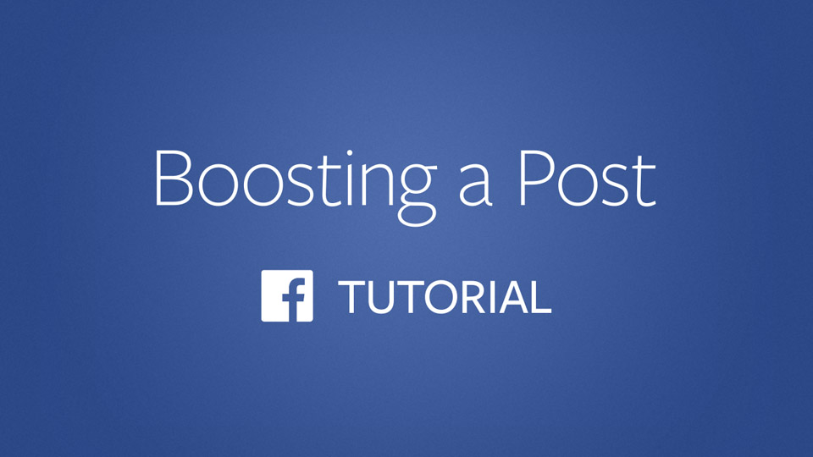
Video Tutorial Resource from FB
https://www.facebook.com/business/learn/facebook-page-boost-posts/

